Slide 1
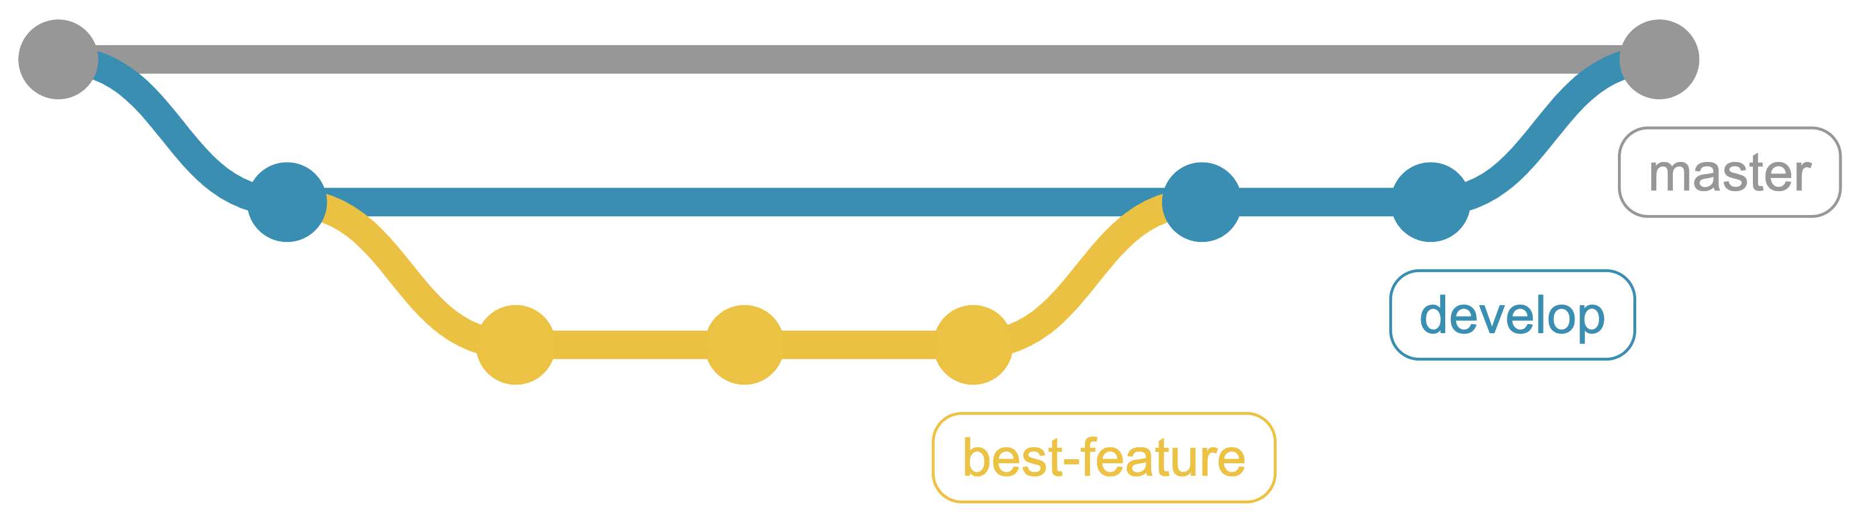
From Punch Cards to Git
A Brief History of Version Control
https://github.com/CuriousCurmudgeon/history_of_vcs
Notes:
(Close Slack + plus other tools. I assume I’ll need Teams open for the actual talk.)
Good afternoon and welcome to the last talk of the day. This is not a technical talk, so I encourage you to just sit back and relax. My goal is to cover over fifty years of version control history in ~45 minutes to leave time for questions/comments. We have a lot to get through, so let's dive right in.

Slide 2


Brian Meeker
Website: https://brianmeeker.me/
Twitter: @CuriousCurmudge
Notes:
My name is Brian Meeker. I work remotely as a consultant for InfernoRed Technology from Richmond, Indiana.
Outside of work I’m a father to two wonderful young girls, play too much Magic: The Gathering, and damage my hearing with only the loudest of metal.

Slide 3
Look for the dragon right outside of Salon A.
Notes:
If you want to chat afterwards, feel free to stop by the InfernoRed booth right outside of this room, Salon A.

Slide 4
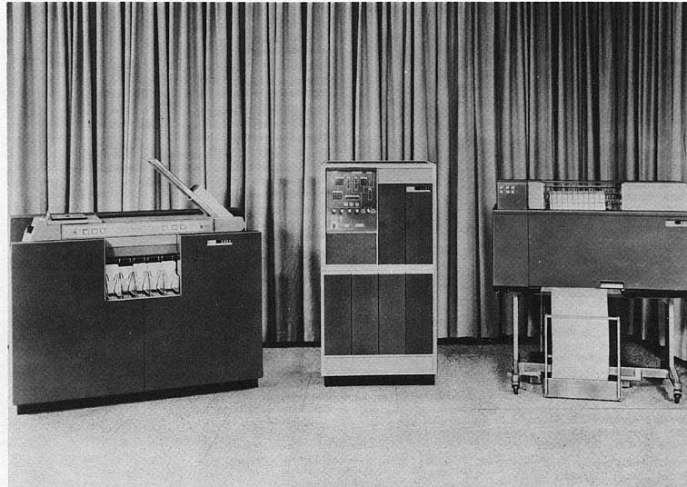
Wikimedia Commons / Gobierno de los Estados Unidos
Notes:
So, you're here for a history talk, which is a great excuse for me to put my imaginary history minor to use. You see, I took all the courses to get a history minor, but never actually talked to anybody in the history department about it, so... I don't actually have a history minor. But I put in all the work, and I think that's the important part. I'm pretty sure that avoiding the paperwork and the human interaction required to complete a task is the most stereotypical software developer behavior you can imagine.
The other motivation for this talk came from CodeMash last year. I want to thank Jenny Manning for doing her talk at last year's CodeMash - Mommy, where do new programming languages come from? last year. Her talk was the inspiration for me submitting this talk and speaking here this year.
And for the curious, from left to right those are a
IBM 1402 Card Read Punch, Model 1 - $24,800
IBM 1401 Processing Unit, Model A-1 - $70,500
IBM 1403 Printer, Model 1 - $30,300
Total Price $125,600 (in 1961)

Slide 5
What is version control?
…the management of changes to documents, computer programs, large web sites, and other collections of information.
- https://en.wikipedia.org/wiki/Version_control
Notes:
So, what is version control?
I am not above stooping to Wikipedia for definitions. This one is pretty straightforward and probably matches your intuition about what version control is.

Slide 6
What is version control?
…a system that records changes to a file or set of files over time so that you can recall specific versions later.
- https://git-scm.com/book/en/v2/Getting-Started-About-Version-Control
Notes:
But I like this version from the official Git book more. I like that it calls out recalling specific versions later.
You'll notice this definition doesn’t lay out any specific requirements about what features a version control system needs to have. You just need to record changes so you can get back to a specific version if needed. That's it.

Slide 7
Terminology
VCS = Version Control Software/Version Control System
SCM = Source Control Management/Software Configuration Management
Revision Control
Notes:
There are also a couple of different terms for version control.
VCS = Version Control Software/Version Control System
SCM = Source Control Management/Software Configuration Management
Revision Control
I’m going to try and be consistent here and use the term “version control system”.

Slide 8
Out of Scope
Hosting services (SourceForge, GitHub, Bitbucket, etc.)
Integrated version control
Wikis
Most commercial systems
Notes:
These topics are interesting, but out of scope.
Repository hosting services like Sourceforge, GitHub, and BitBucket.
Integrated version control, like you see in modern word processors, spreadsheets, or content management systems.
Wikis
Most commercial systems, with one important exception.

Slide 9
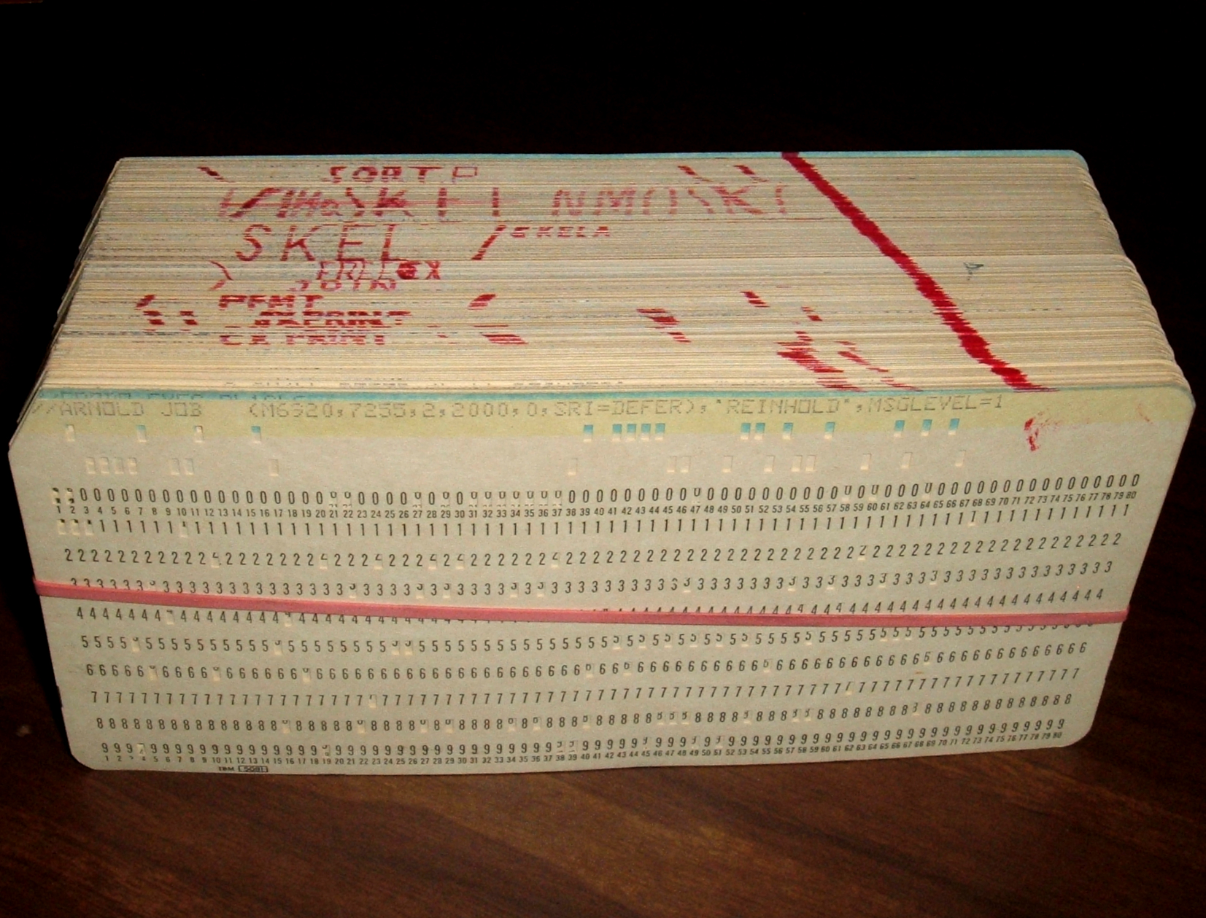
Punch Cards
Wikimedia Commons / Arnold Reinhold
Notes:
So, when I originally came up with the idea for this talk, I put “punch cards” in the title because ”From Punch Cards to Git” seemed like a really snappy title, but then I had to figure out what the punch card part of that even meant. This may surprise you given my quickly greying status, but I’m not old enough to have ever used punch cards. I'm pretty confident that is true of almost everybody here.
These are punch cards. Imagine that is is 1964ish and that you have just received a new assignment. You've looked over the requirements and you're written out your code by hand. Now you need to get your code ready.
There is no concept of version control as we understand it here, but what we can do talk about how a programmer would maintain his punch card deck with the understanding that it is not version control.

Slide 10
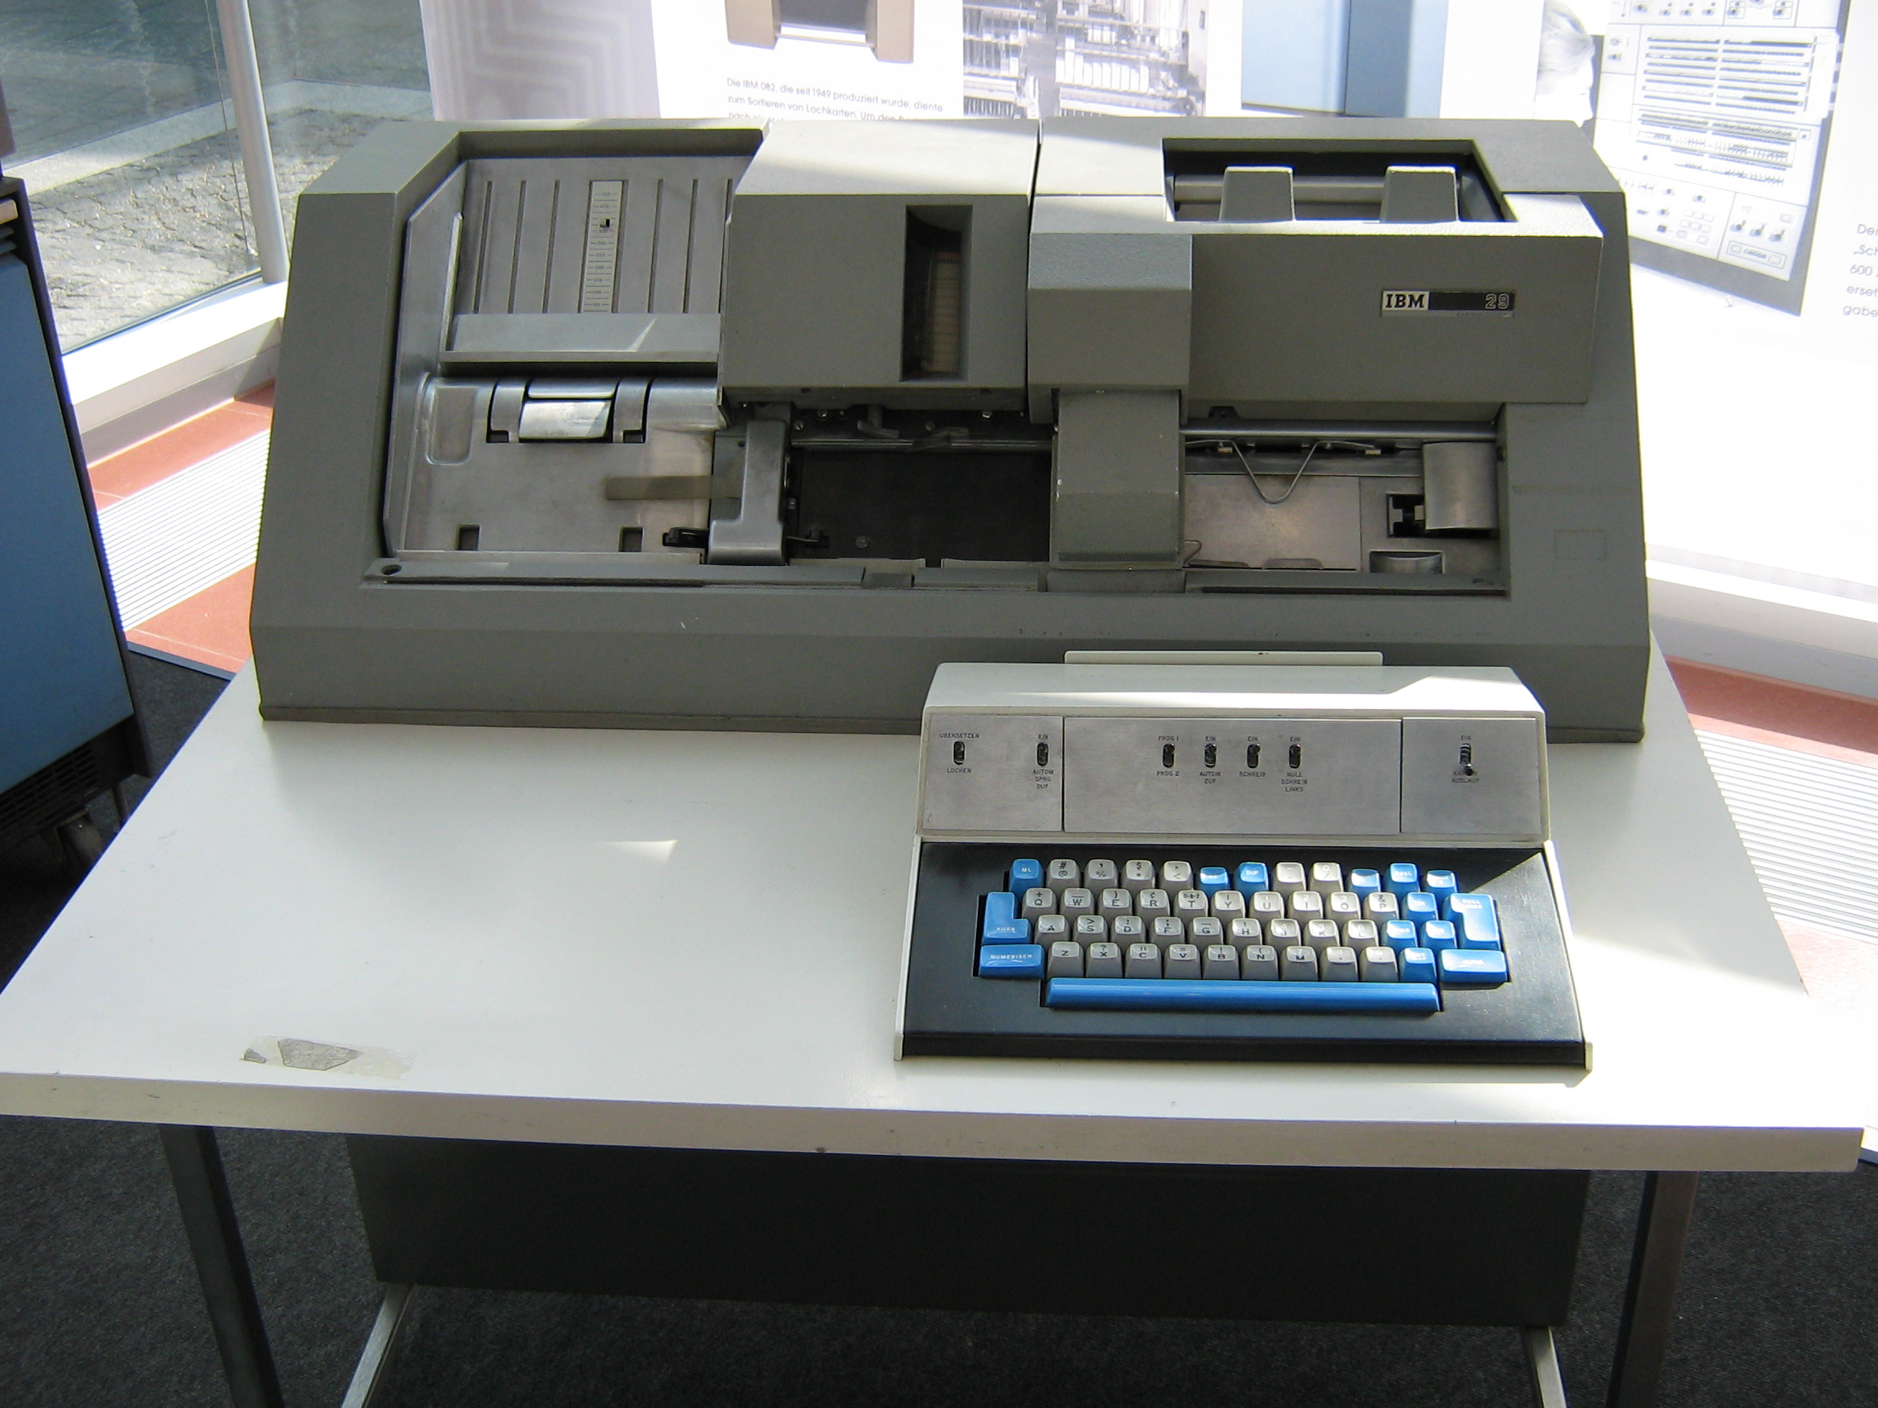
Keypunch Machine
Wikimedia Commons / waelder
Notes:
This is a keypunch machine. After writing your program on coding sheets, you would take your sheets over to a keypunch operator. The keypunch operator would use this machine to turn your written source code into something that could be fed into a computer.
This model specifically is the IBM 029 Key Punch. It was introduced in 1964 at the same time as the IBM 360.

Slide 11
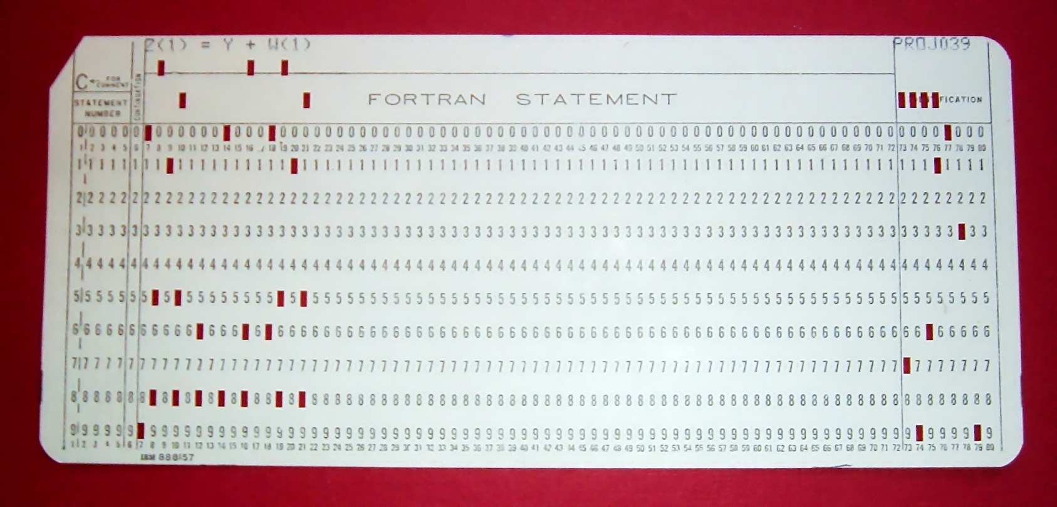
Running Your Program
Wikimedia Commons / Arnold Reinhold
Notes:
So, now you have punch cards for your program, but could a computer directly run these punch cards?
Look closely at the top of the card here. What do you see? Source code. The punch cards from the keypunch machine are just your source code in a format that can be fed into the computer.
And what do we do with source code before the machine actually runs it? We compile. Some languages today still make this an explicit step. Some do it implicitly, but the code is always compiled before the machine can run it. Even with punch cards.

Slide 12
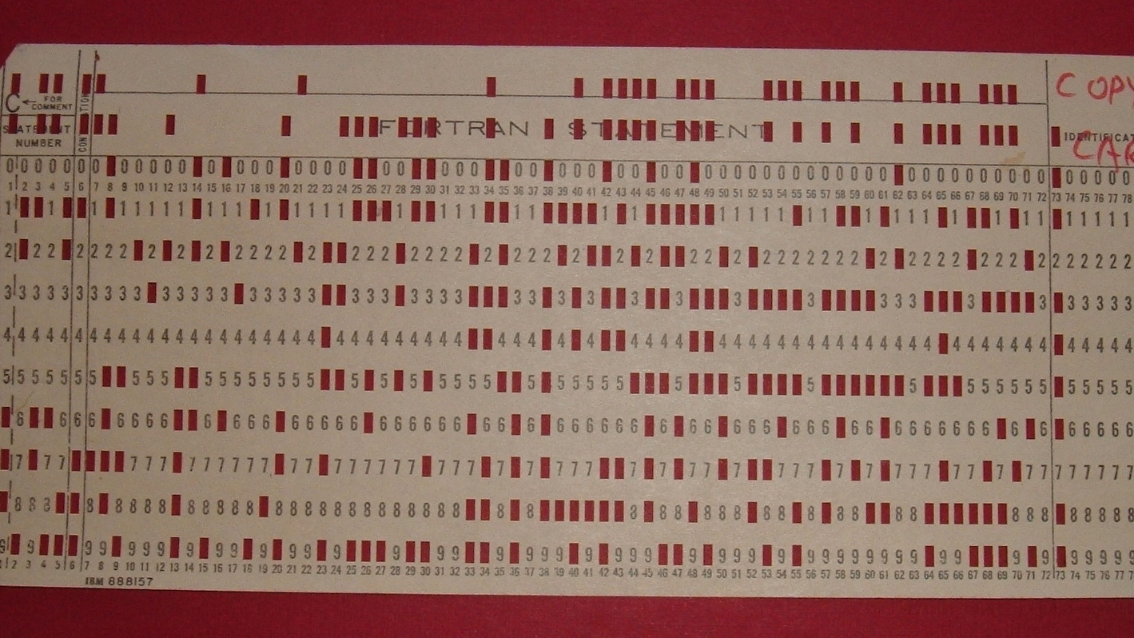
Compiled Punch Card
Wikimedia Commons / Arnold Reinhold
Notes:
So you would take your punch card deck to the computer operator and they would attempt to compile it for you.
This particular compiled card contains a self-loading IBM 1130 program that would copy the deck of cards placed after it in the input hopper.
If you were incredibly lucky/good/fortunate to have a simple task, then your program would compile the first time. Let's assume it did compile correctly though. Next, the computer operator would load your deck of compiled punch cards into the machine to execute the program. You would then get back your original deck, compiled deck, and printed output.
Now, chances are good that your program didn't work correctly the first time. It almost never does and you have to remember that these programmers had no real time feedback. There was no test suite running constantly. No debugger. No IDE. Nothing. So, now we can finally get to the real problem. How did a programmer manage changes to their punch card deck?

Slide 13
Wikimedia Commons / Arnold Reinhold
Notes:
First, your helpful keypunch operator would often draw a diagonal line like this across the top of your cards. Now, if you dropped your deck, you could put it back in order by recreating the line. Not the most robust system, but the opportunity cost is extremely low.
But what would happen when you start making edits to your deck. The keypunch operator shouldn't have to type up a new copy of your deck every time you make a change. As a programmer, you should be able to type up a new card as needed to insert into your deck. However, your line won't be very useful in that case. It will quickly become a jagged mess.

Slide 14
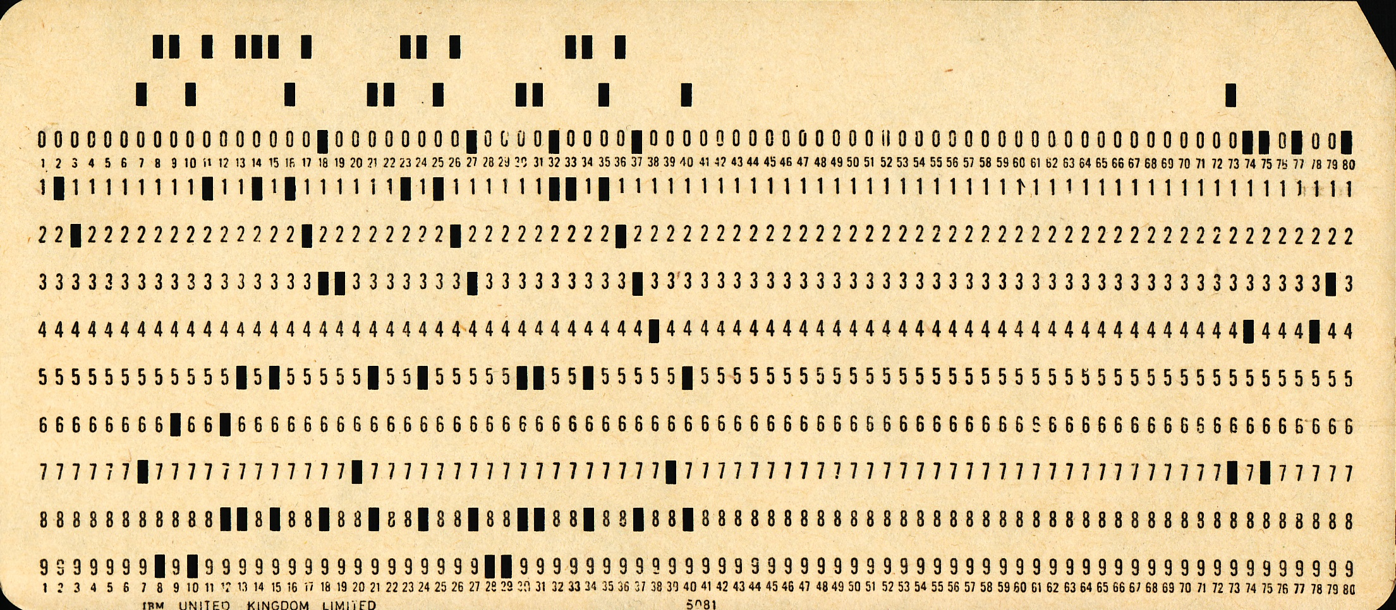
Sequence Numbers
PUX 430
Wikimedia Commons / Pete Birkinshaw
Notes:
One solution for this is sequence numbers.
A standard punch card had 80 columns. If you look closely at this card, you will see the columns labeled at the top and bottom all the way to 80. However, it was common practice for compilers to only look at the first 72 columns on the card. So, that gives us 8 unused columns and those columns are the key to ordering the deck.
I did not spend the time to get good at reading these cards, but apparently this is another Fortran card with the sequence number “PUX 430”

Slide 15
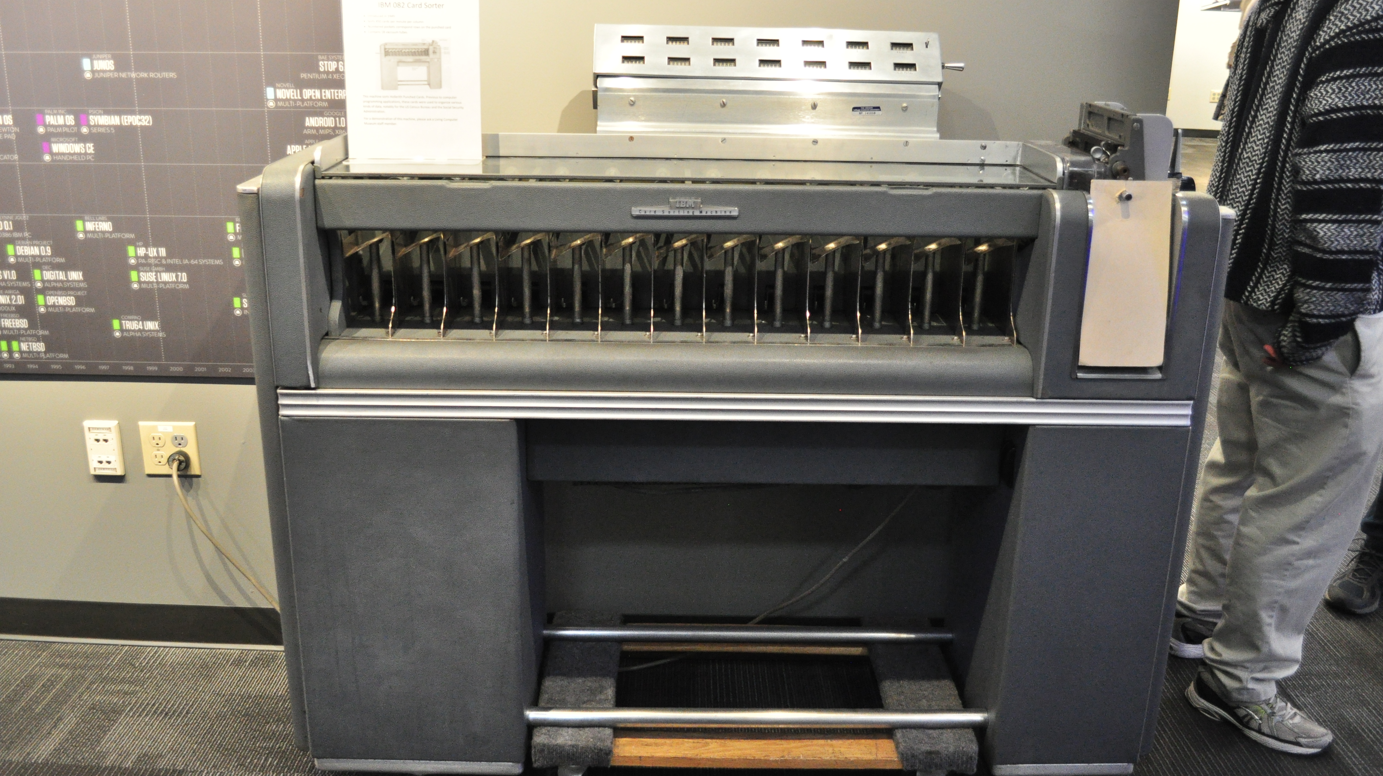
Punch Card Sorter
Wikimedia Commons / Joe Mabel
Notes:
This is an IBM 082 card sorter at the Living Computer Museum in Seattle. This model came out in 1949 and could sort 650 cards per minute. If your deck got out of order, you could use a machine like this to sort a deck by sequence number.
That kinds of just shifts the problem around though. What if we have our sorted deck and we want to insert a new card in the middle of our program. For example, we want to insert a new card 32 and shift the rest of the deck back. How do we easily renumber our cards?
Easy, you write a program for it. You feed your deck into the machine in the new order. The machine ignores the existing sequence numbers and copies your deck with new sequence numbers.
There are still a lot of limitations here. Getting new sequence numbers is automated, but if you put a card in the wrong spot in the deck you won't have any record of that. Depending on the mistake you might not realize anything is wrong until your program executes.
There's also no trail of any changes. Collaborating with another programmer on a problem is very difficult. You would have to very, very carefully negotiate who is working on what. And even when working by yourself, you can't look at your history and figure out where you introduced a bug.

Slide 16

Wikimedia Commons / Marcin Wichary
Notes:
For awhile while putting together this talk, I thought that sequence numbers and punch card sorters were the end of the line for the punch card era. And that was true for the vast majority of programmers of the day. However…

Slide 17
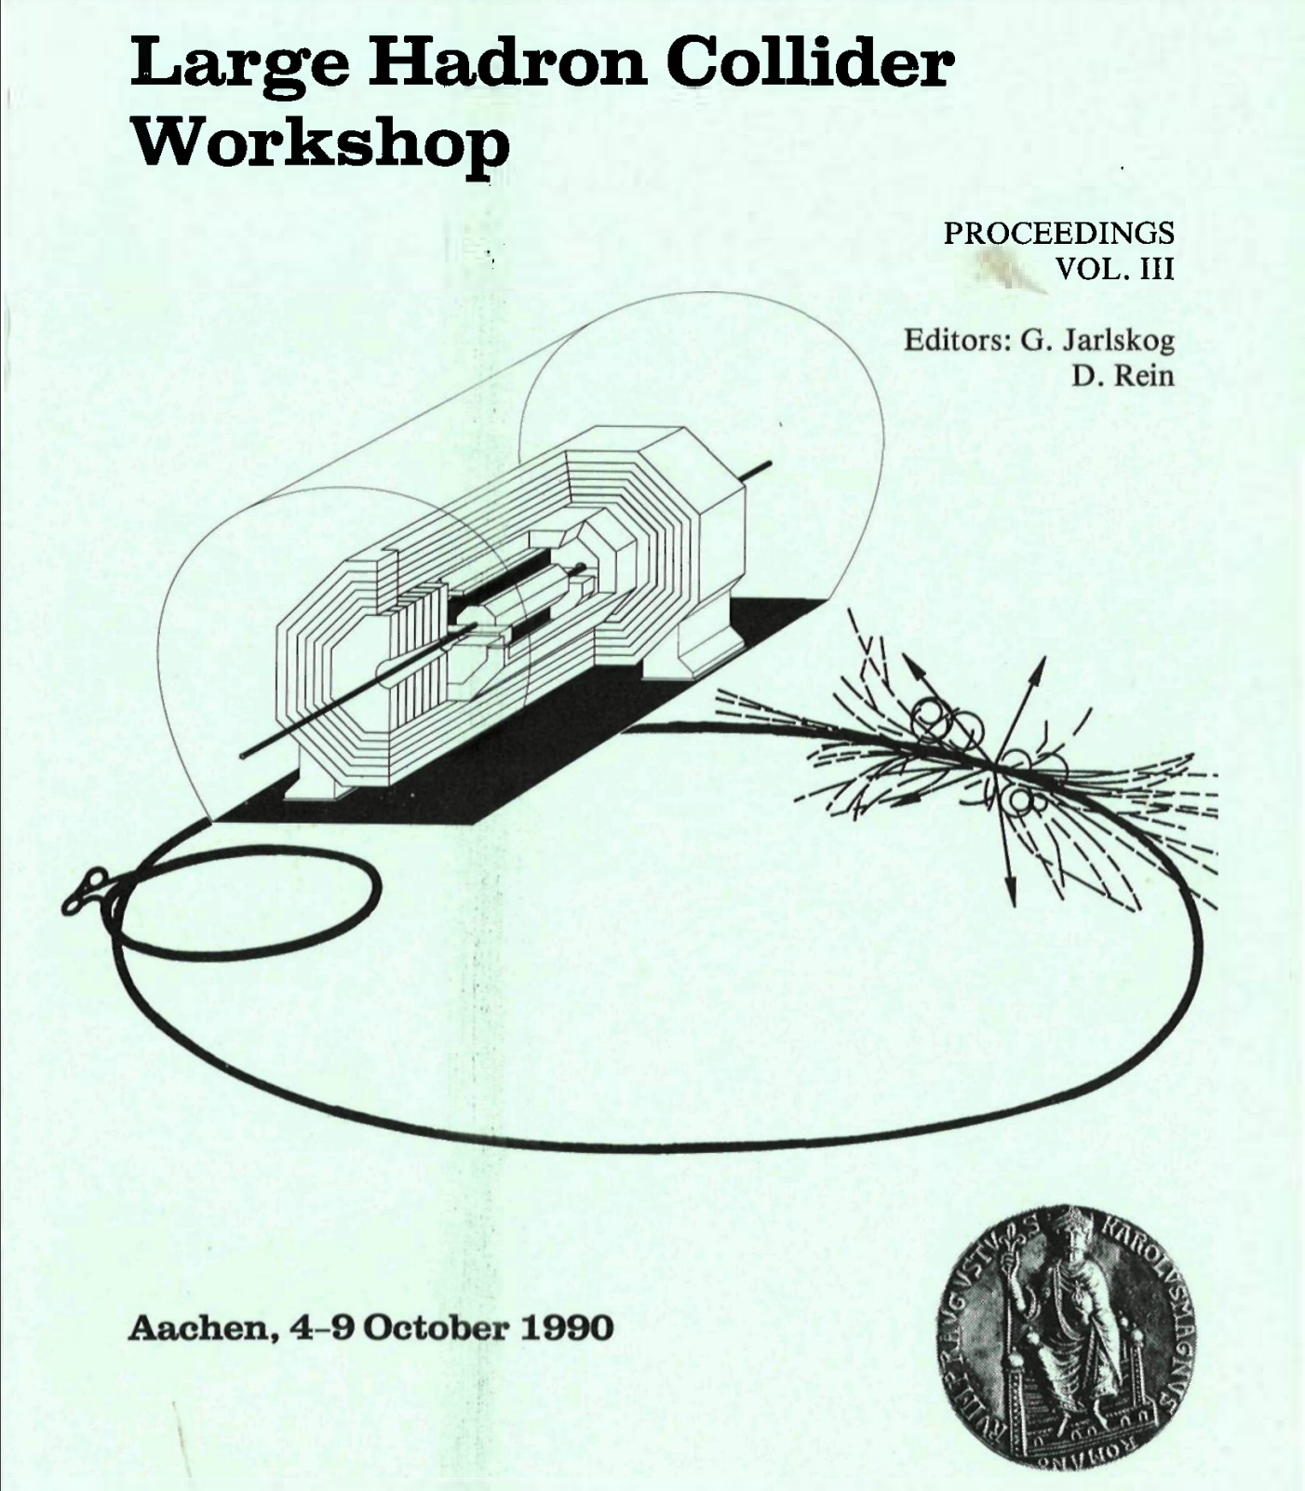
Progress is not evenly distributed
International Atomic Energy Agency
Notes:
…progress is not evenly distributed. I stumbled upon the proceedings from a Large Hadron Collider workshop in October 1990. If you were a researcher at CERN in 1965 there was something else you could have used. And if you were still a CERN researcher in 1990, you might still have been using the same system because progress is not evenly distributed.

Slide 18
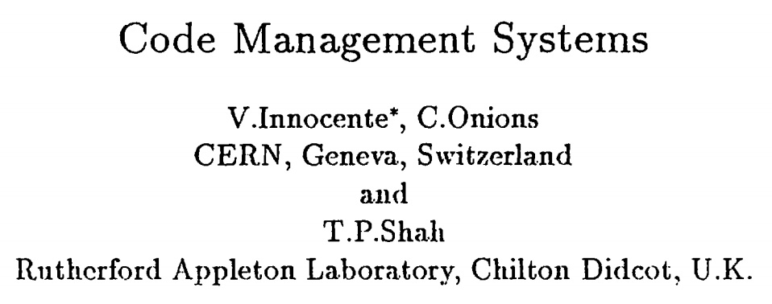
Notes:
These proceedings contain a summary of “code management systems” being used by CERN researchers.

Slide 19
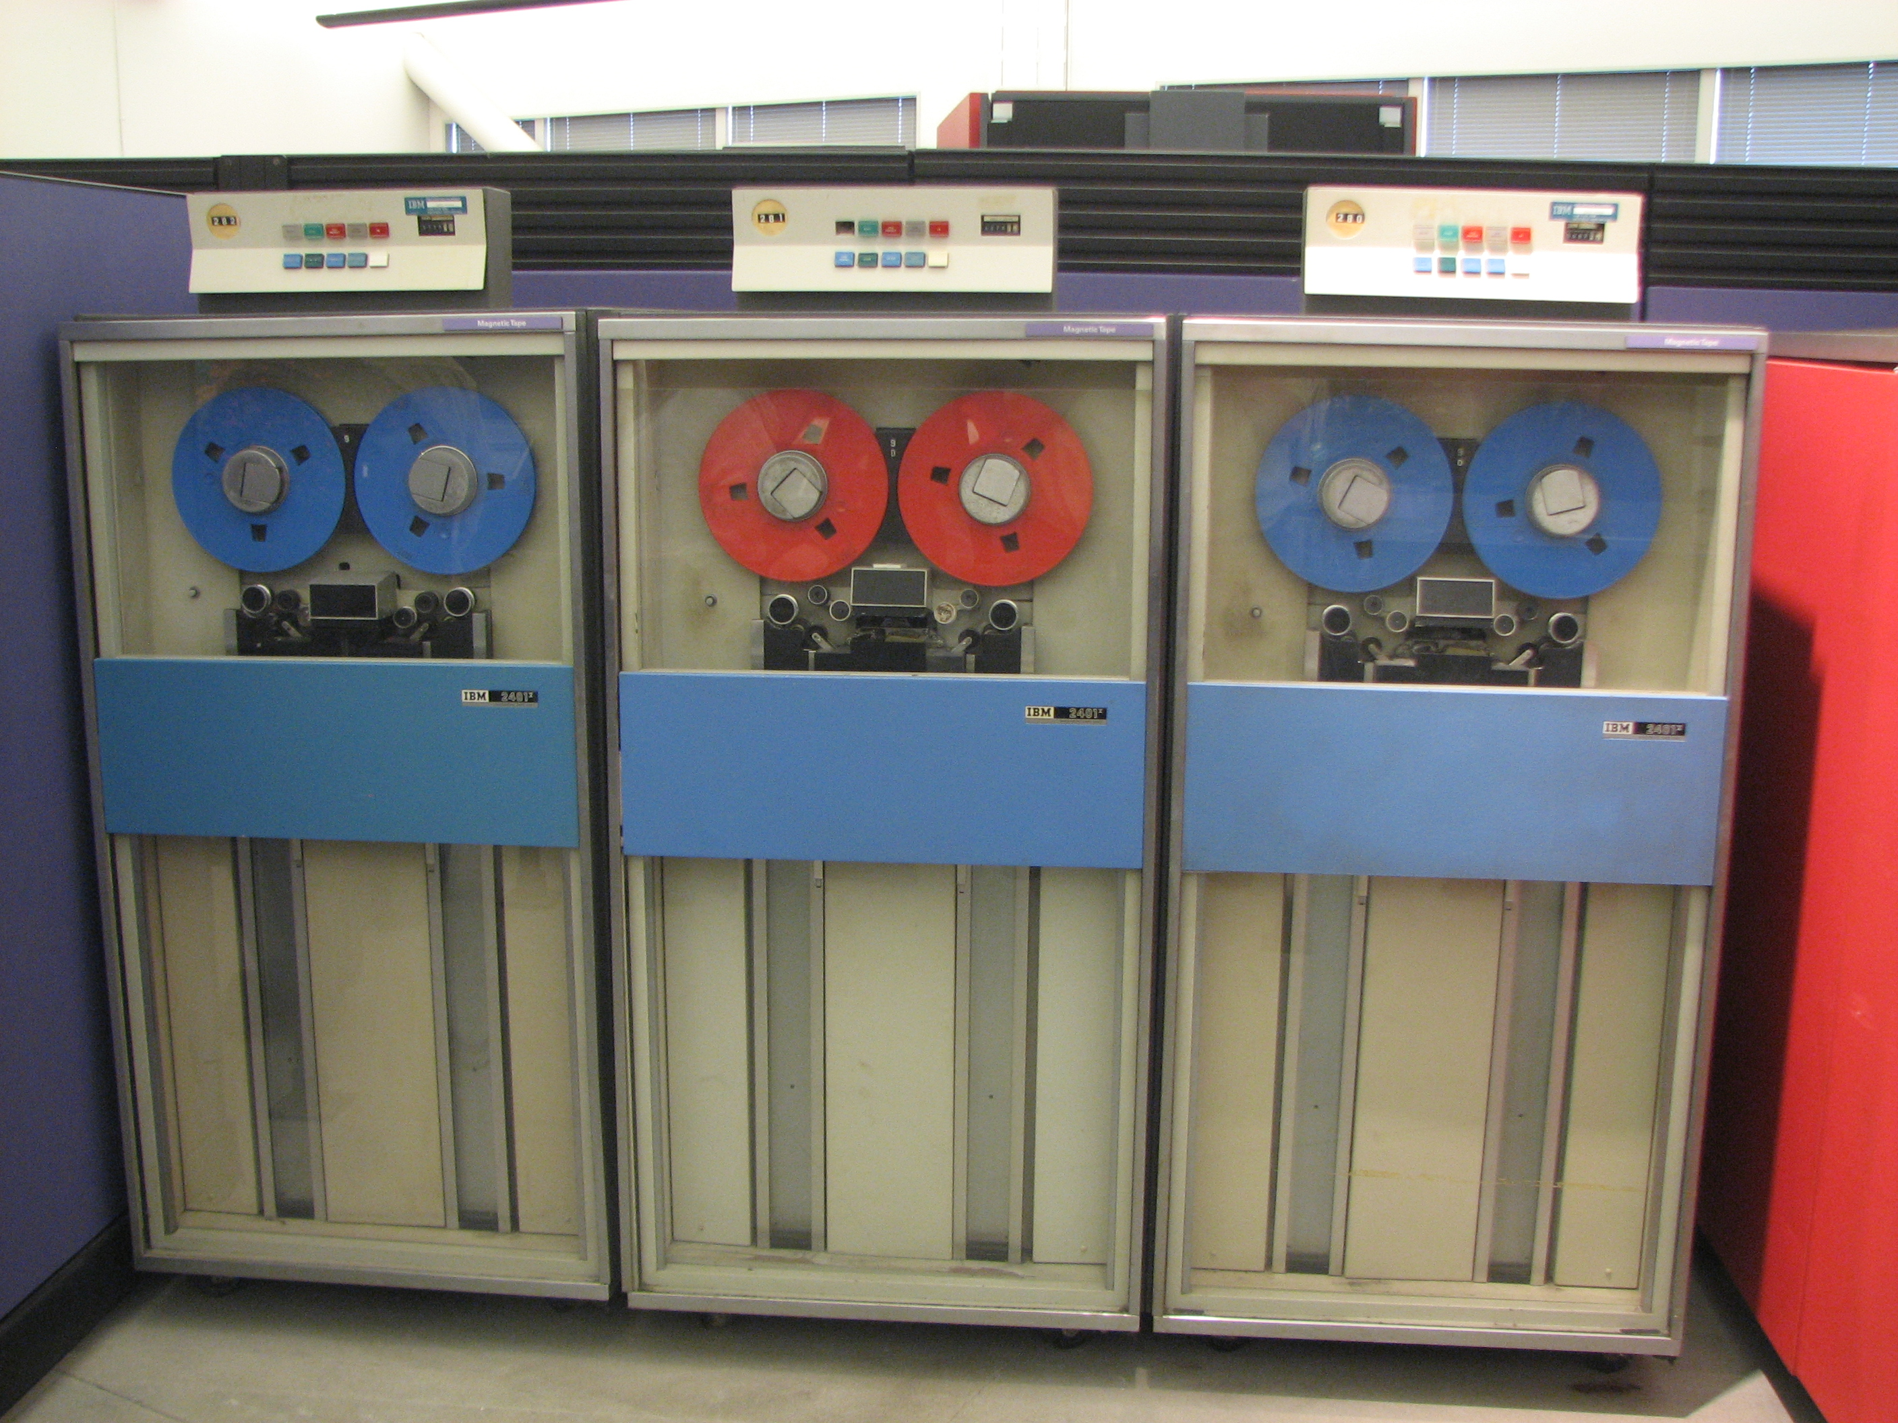
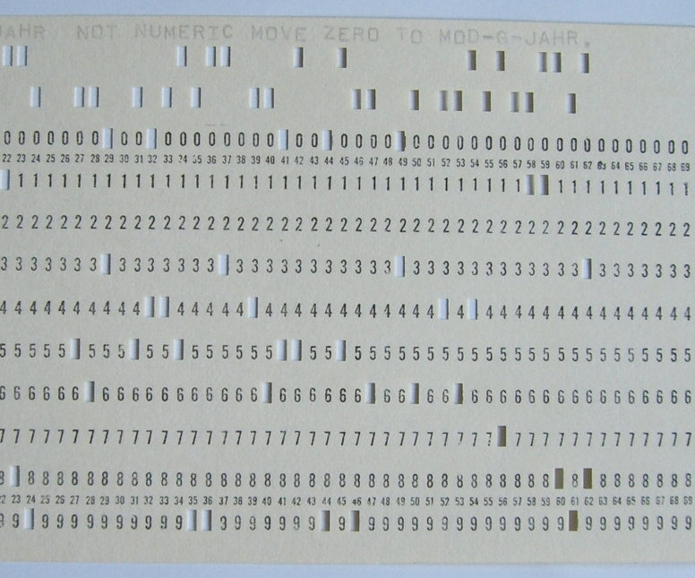
PATCHY
Wikimedia Commons / Erik Pitti
Wikimedia Commons / Rainer Gerhards
Notes:
The first system they mention is the one that interests us. It's called PATCHY and, at the time, was the most widely used ”code manager” in the high energy physics community.
PATCHY is not a version control system, but it’s an interesting advancement from punch cards. The source code would be loaded onto tape and then correction cards could be fed into the system to update the program on tape. History could be maintained if all changes were made via correction decks.
It’s primary strength within CERN was for distributing code to other sites on tape. Correction decks could also be circulated to update an existing tape, but that was less reliable.
PATCHY is still used today, although I’m not sure how much. I found release notes dated as late as October 2016.
REFERENCE: Don’t read
PATCHY [1] was developed at CERN around 1965 at a, time when programs were fed to the computer via a card reader. By maintaining the source code in a PATCHY Master file (PAM) on tape and using a small cradle of update cards the user was freed from the burden of reading in a tray full of cards! It reads in and acts upon several sequential files by means of cards. PATCHY, because of its origins, is not an interactive program at all. Because it accesses the data sequentially PATCHY is necessarily slow or cumbersome in those facilities best provided by random access.
PATCHY handles common sequences well and conditional code can also be managed but in a slightly more complicated manner. History of code development can only be maintained if all changes are made via correction decks at the start of the PAM file. In particular, if source code is modified directly using the local editor then no history is available (unless done manually by way of a comments deck at the start); there is no automatic way of going back to an earlier version in this case. The updating process cannot be controlled or monitored in any way. PATCHY is very good for distributing code to other sites on tape and correction decks can be circulated for the PAM files in other centers but no guarantee that they would apply to the correct version(s) of the PAM file. PATCHY, as already mentioned, has been the most widely used code manager in the HEP community.

Slide 20
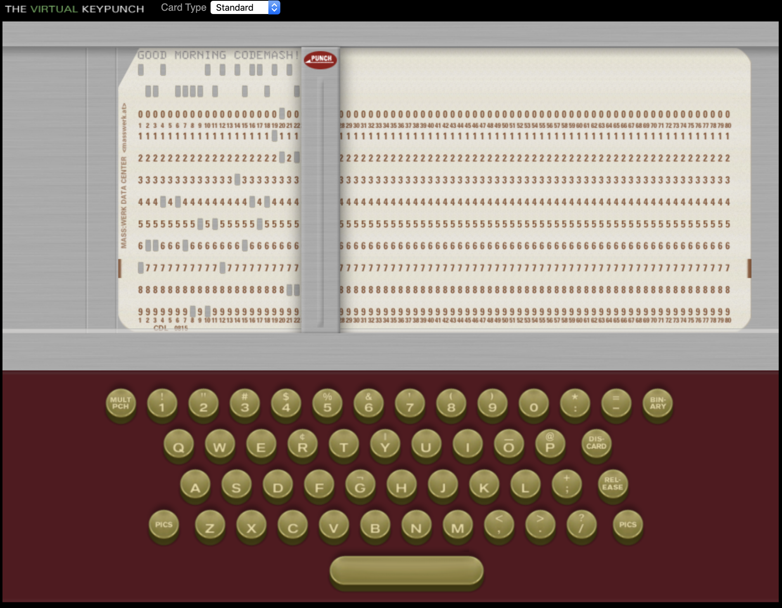
The Virtual Keypunch
https://www.masswerk.at/keypunch/
Notes:
If you want to play around with punch cards yourself, I highly recommend The Virtual Keypunch. Things clicked a lot better for me once I could sit there and virtually type on the keyboard.
But, as far as I can tell, this as far as the punch card world got. We were about to enter the world of multi-user operating systems and teletypes. Pretty soon punch cards would begin to fade out and source code would live on the computer itself. Which meant it was time to start looking into software to manage it.
(7 minutes)

Slide 21
First Generation
Generation | Networking | Operations | Concurrency
First | None | One file a time | Locks
Second | Centralized | Multi-file | Merge before commit
Third | Decentralized | Changesets | Commit before merge
https://ericsink.com/vcbe/html/history_of_version_control.html#ftn.idp96624
Notes:
As we go through history we're going to refer to this table to reorient ourselves. The history of version control can be broken down into three generations based on certain features. The first generation is defined by no networking, only versioning one file at a time, and locks.

Slide 22
Source Code Control System
SCCS
Notes:
Like most ideas, there are a lot of pre-cursors that had some elements of version control, but it's widely agreed that SCCS (Source Code Control System) is the first true version control system. The systems that existed before SCCS were mostly about deltas. And while deltas are extremely valuable, they do not make a version control system.

Slide 23
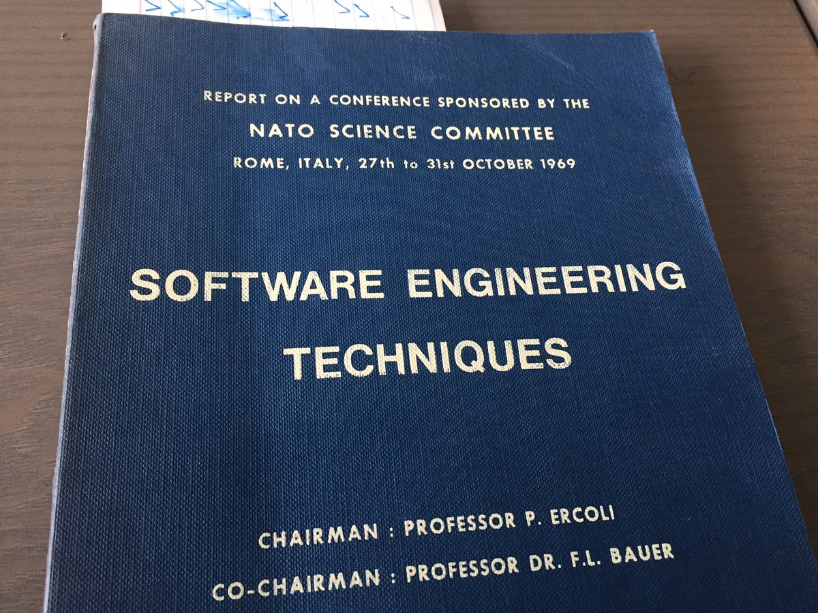
IBM CLEAR
https://twitter.com/bokmann/status/893225721556078592
Notes:
One of those systems was IBM’s CLEAR, which "tried to assist with the administration and accomplishment of the program development lifecycle."
The only information about CLEAR that I was able to find was from a software engineering technique's conference sponsored by the NATO Science Committee in 1969. One part of CLEAR used deltas to help with versioning releases.
This was the second of two NATO software engineering conferences. The term “software engineering” was not in general use yet. Using the term to title these conferences was an important step in the giving the term legitimacy.

Slide 24

Notes:
Bell Labs logo from 1969-1983
So then we come to Bell Labs; be honest, is anyone surprised that the first VCS came out of Bell?

Slide 25
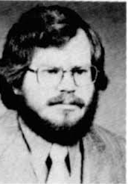
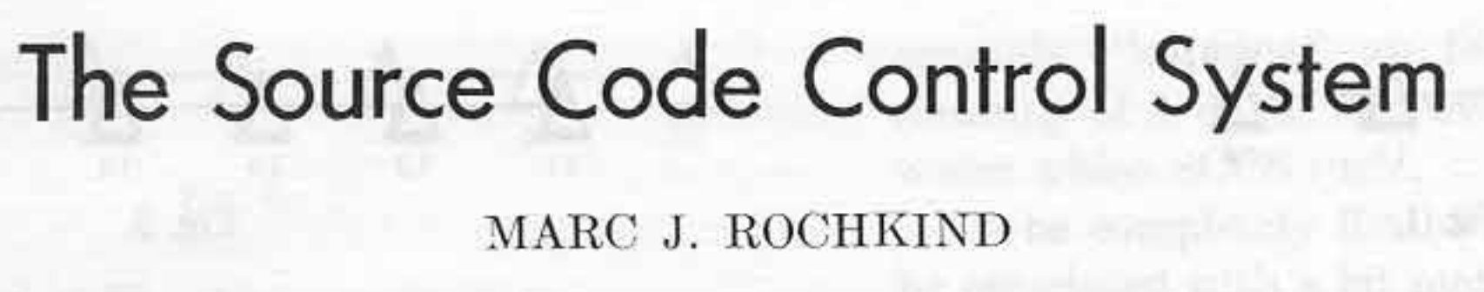
Notes:
The year is 1972. Marc Rochkind is working at Bell Labs and struggling to deal with change management. He would summarize his work in his 1975 paper The Source Code Control System. In it he describes the four problems he was trying to solve.

Slide 26
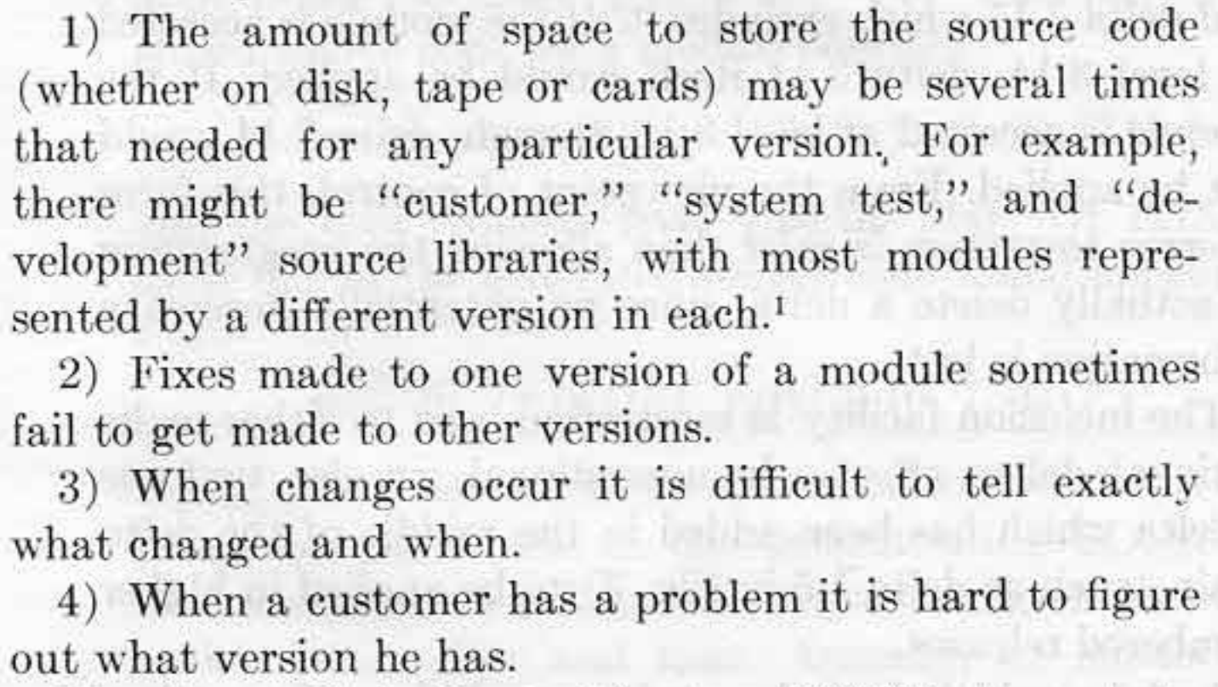
Notes:
Don’t feel like you need to read all of that though because we’re going to go through it. These are the problems that Marc was trying to solve in 1972.
1. Save space.
2. Manage versions.
3. Track who changed things and when
4. Knowing what version the customer has.
It's important to remember that memory was precious at this time. The size of files on disk was important, so an efficient storage format was essential.
Distribution of releases was also difficult. There was no internet. Computers were still only owned by large organizations. If you were distributing software, chances are it was an "enterprise" model and customizations for the customer were common. Dealing with versioning of all these releases was a challenge.

Slide 27
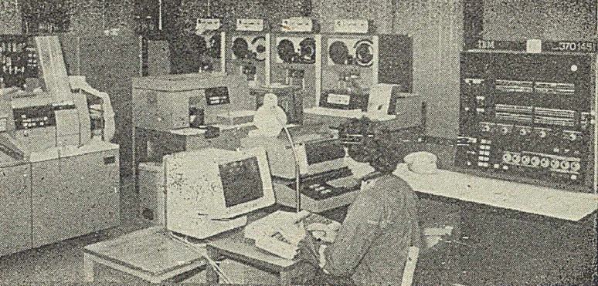
SCCS Prototype
SNOBOL: StriNg Oriented and symBOlic Language
SPITBOL: Speedy Implementation of SNOBOL
IBM System/370
OS/MVT: Multiple Programming with a Variable Number of Tasks
Wikimedia Commons
Notes:
This was the tech stack for the initial prototype.
They felt that the concept of version control was too out there to win people over with a specification, so they prioritized ease of development. SNOBOL 4 was chosen because of it's expressive power and ease of use. For it's day it was an incredibly powerful language. One person was able to write the initial prototype in three months. Depending on the domain you work in, that might seem fast or slow to you, but you have to remember that this is 1972. In 2020, we stand on the shoulders of giants. This is quite a few shoulders below us.
The downside of SNOBOL 4 and SPITBOL was size and speed, but that wasn't an issue during the six month trial run.

Slide 28
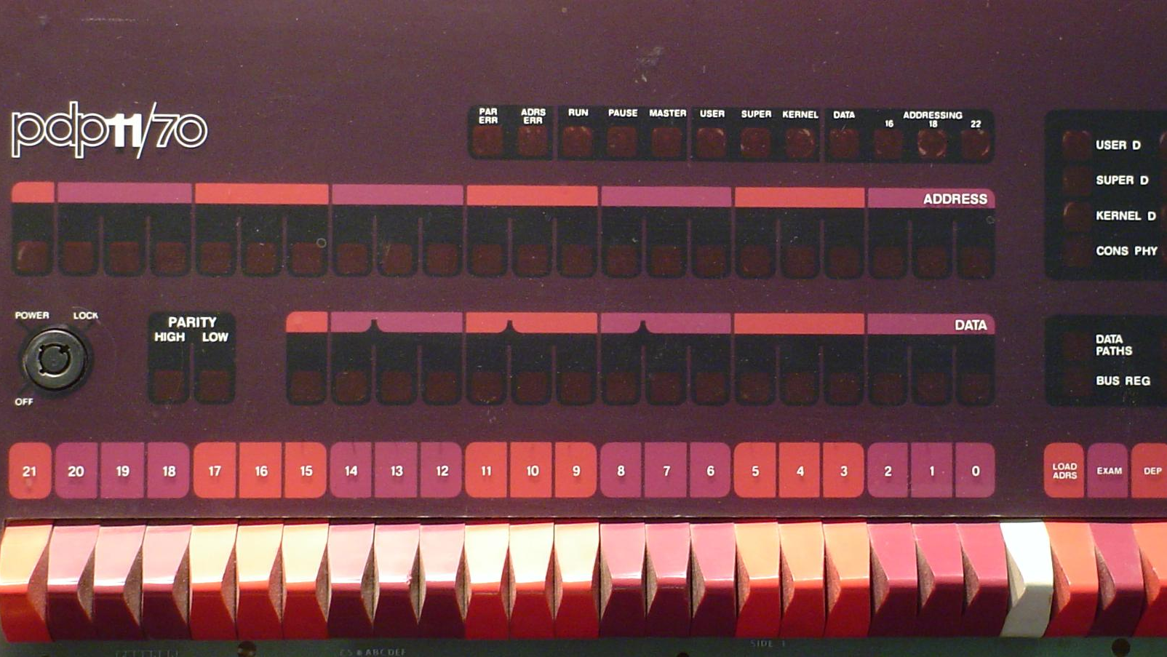
Wikimedia Commons / Dave Fisher
Notes:
The prototype was very successful and several large applications were using it internally. In the fall of 1973 there were several more projects interested in using SCCS and the decision was made to write a new version. The interested projects were on multiple OS's, but the existing version of SCCS only supported OS/360 still. Instead of writing different versions for each OS (which was standard operating procedure then), they decided to write just one version that would run on a PDP 11/45 under UNIX.
Source code would be stored on the PDP 11 and sent to the appropriate machine for compilation. Given the future dominance of UNIX, this turned out to be a wise decision.
This is a picture of a PDP-11/70, which was an upgraded version of the PDP-11/45.

Slide 29
SCCS Features
Single file
Locking
Release management
Notes:
So, that's all well and good, but how did SCCS work?
If you remember the features from the first generation, you’ll remember that it only works on a single file at a time, that file gets locked when checked out for editing, and there is no networking.
Working on a single file at a time will probably feel a bit alien to just about everybody in this room. Each file was a module that was versioned independently.
Release management is interesting though. It's different from what we do today, so let’s talk about that a bit.

Slide 30
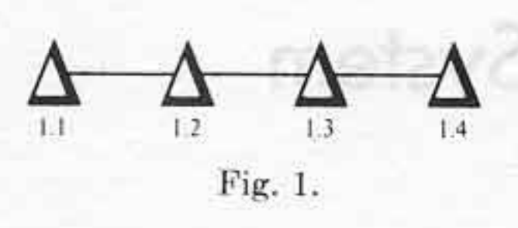
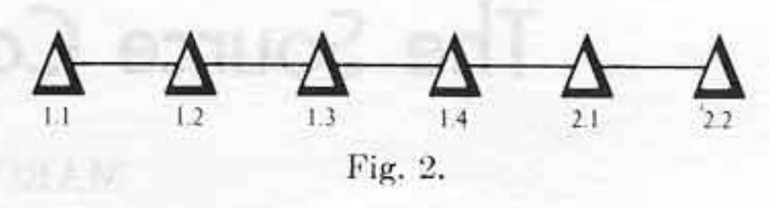
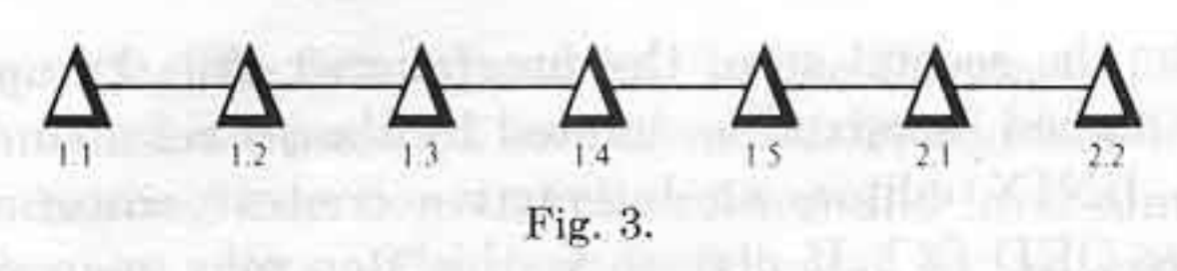
Releases
And
Levels
Notes:
These figures are from Rochkind’s original 1975 SCCS paper.
I mentioned that managing the versioning of releases was a very big problem that SCCS hoped to tackle. It did this through the concept of releases and levels. Each commit would increment the level of a release. For example, when you create a file, it is at Release 1, Level 1, or 1.1. Committing a delta would increment the level to 2, so now we're at 1.2. The release number would only increment if you explicitly started a new release with a command.
You had a lot of power over managing those releases. For example, if you needed to make a fix to release 1, but release 2 is the most recent, you could explicitly checkout the latest level from release 1 and make a change. That change would not apply to release 2. You would have to make the change in release 2 by yourself if necessary.
This was not actually the original behavior though. In this example, 1.5 was added. That delta would have been included in release 2. They originally thought this was a good idea, but experience taught them otherwise. This means that, in the diagram, 1.5 is NOT part of release 2 because it was added later. There’s no explicit concept of branching here, but you could think of each release as starting a new branch.
You also had a lot of power to search and display history, but I'm not going to dive into that here.

Slide 31
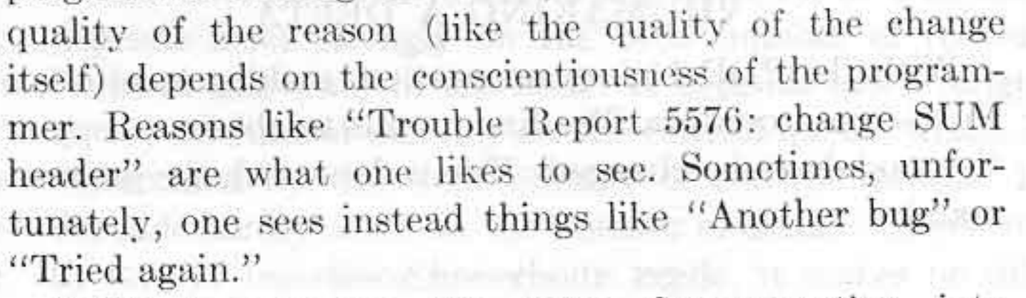
Notes:
In 2020 we have mastered informative and conscientious commit messages, right? I’m assuming none of you work on teams that commonly use commit messages like this. /sarcasm
Even in 1975 Rochkind was lamenting the lack of good commit messages.

Slide 32
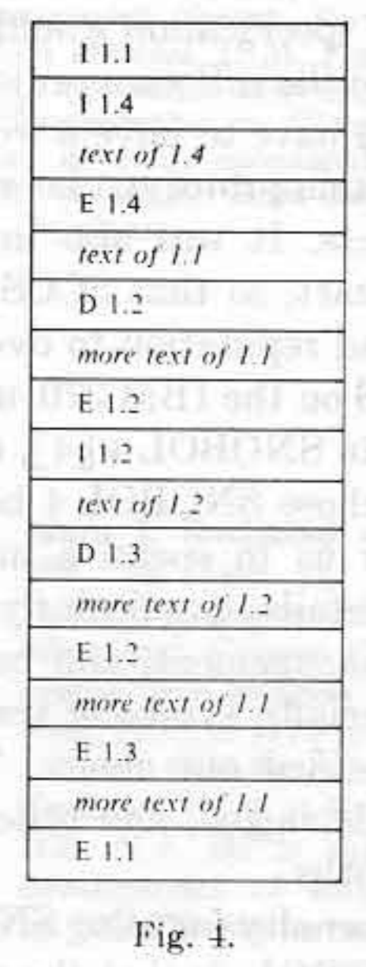
Interleaved Deltas
The attempt by SCCS to record every version of every module that ever existed is rather ambitious. The system would be impractical unless it used a storage technique and accessing algorithm that allowed many deltas to be kept at a reasonable cost in terms of disk space and processing time.
- Marc Rochkind (The Source Code Control System)
Notes:
We’re not going to talk about too many implementation details today, but I do think it's important to talk a bit about how SCCS worked to set a baseline for comparison.
The core of SCCS is something called interleaved deltas. In his 1975 paper, Rochkind describes the problem he was trying to solve. (Quote on slide)
He wanted something that was both space and processing efficient. Interleaved deltas satisfied both requirements. The space required to store the delta is only slightly greater than the amount of text inserted by the delta. Access speed was mostly flat. Any level could be reached in equal time.
All changes are stored with just two primitives. Lines are either being inserted or deleted. You can see on the initial commit some control records and text records. ”I” stands for Insert and “E” stands for End. The rest of the highlighted records are the initial text.
You can see the changes highlighted in 1.2 “D” stands for Delete. You can see that some text from 1.1 was deleted and some new text was inserted.

Slide 33

Finding Inspiration
Pamela Vong
Notes:
So, how did Rochkind come up with this algorithm? In 2015, he described how. I love this story because it shows that even in 1972 computer programmers were solving thorny problems by getting away from their work. (http://sccs.sourceforge.net/sccs_invention.html)
Marc was walking his girlfriend's dog. Marc didn't like the dog, so he would let his mind wander when walking it. He had been struggling with the problem of how to store both the source code and the deltas all in the same file. He came up with the idea of surrounding the pieces of text with markers. When he got back to his apartment, he started sketching out details of how it might work.
When he thought he had a workable solution, he enumerated what he thought were all the possible cases of insertions mixed with deletions and worked through each example. From there it was pretty simple to code and he had that part of SCCS running in SNOBOL4 in a day or two.

Slide 34
SCCS Today
http://sccs.sourceforge.net/
https://www.gnu.org/software/cssc/
Notes:
As the first "real" version control system, SCCS was obviously extremely influential, but it also had a surprisingly long life-span. The project started in 1972 but didn't have it's first public release until version 4 on February 18, 1977. It even ended up becoming part of the Single UNIX Specification. It's still part of the POSIX standard, which really makes me wonder what other sort of random, irrelevant by-today's-standards utilities are part of POSIX.
You can still find a modern fork of SCCS that was open sourced by Sun as part of OpenSolaris on SourceForge. That site is actually a treasure trove of information about the history of SCCS. For example, it contains the version 4 release announcement from 1977.
You can also find a link to the SCCS development mailing list! It had a grand total of... one message in 2019. Asking if Windows 10 support was planned.
GNU also provides CSSC, which is their version of SCCS. There is actually one dev (James Youngman) actively making contributions to it this past year. The intent of the project is to help convert old SCCS repos over to a more modern option.

Slide 35
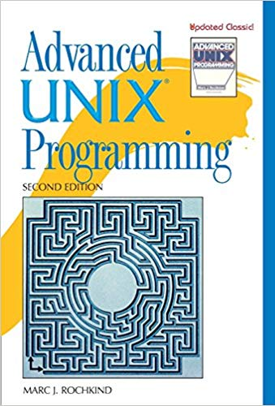
Marc Rochkind
https://basepath.com/
Notes:
Something that will be a bit of recurring theme today is that a lot of the people I’m going to talk about or also well known for other things. In this case, it’s for Advanced UNIX Programming.
Today, you can find Marc Rochkind’s work on his website. I’m not completely sure what he’s doing these days, but, based on his website, it appears that he keeps busy with a wide range of hobby projects.
(< 15 minutes)

Slide 36
Revision Control System
RCS
Notes:
Next up is RCS. I actually have personal experience with this one. This is the oldest VCS that I have personal experience with.

Slide 37
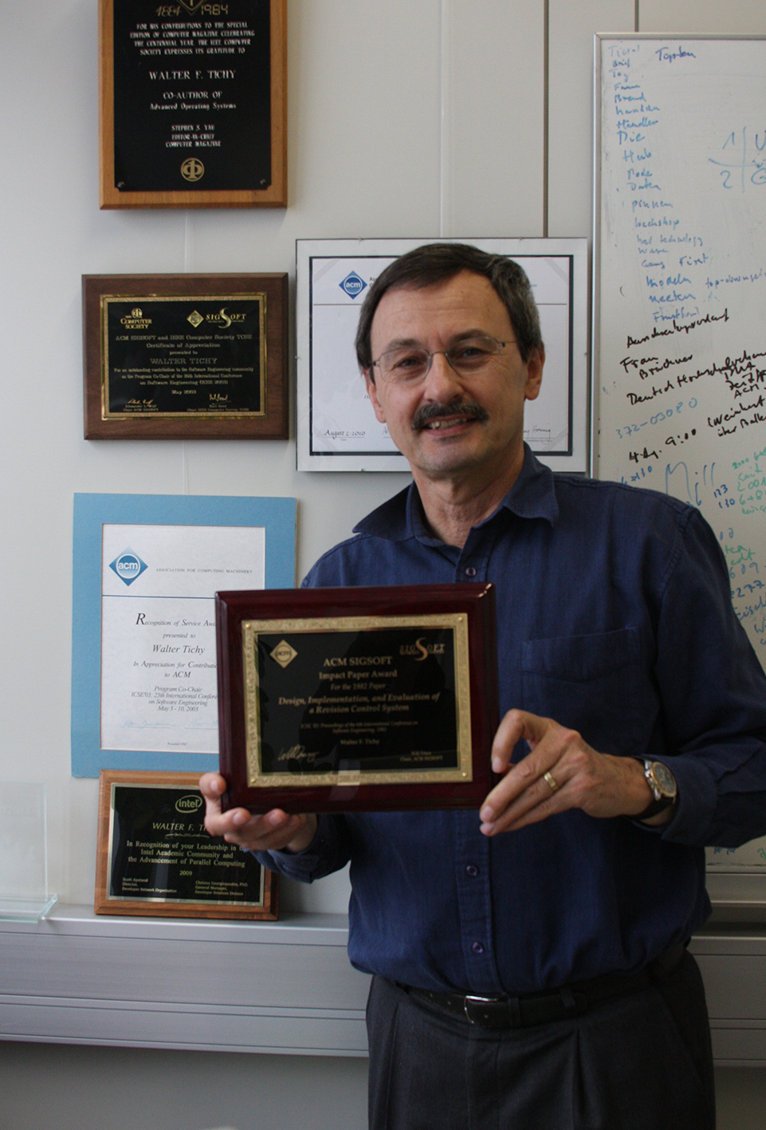
Walter F. Tichy
Created RCS in 1982
Karlsruhe Institute of Technology
Notes:
Tichy, born in 1952, is a German computer scientist. After receiving his PhD he served for six years on the faculty of Purdue University. It was during his time at Purdue that he developed RCS.
Every year, the Association for Computing Machinery (ACM) bestows the ACM SIGSOFT award for a publication that has demonstrated major impact. This picture of Tichy with the ACM SIGSOFT Impact Award he received in 2013 for...

Slide 38
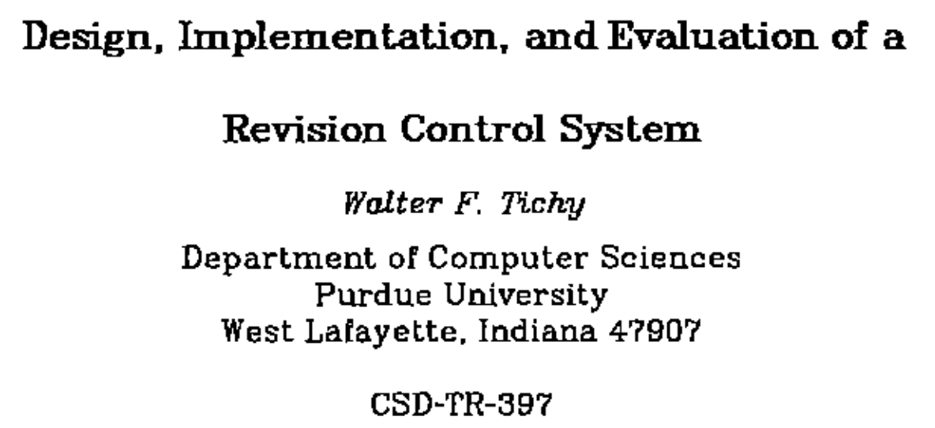
Notes:
...this paper, Design, Implementation, and Evaluation of a Revision Control System.
So, why did Tichy create RCS and what advantages did it have over SCCS? Let's look at his 1982 paper a bit to find out.

Slide 39
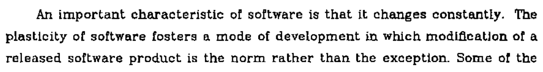
Notes:
Right away in the introduction we get reminded that even in 1982 software was never done. He goes on to state that “ ’Improved’ versions of heavily used software products seem to arise almost spontaneously.”
At it’s core, RCS is a refinement on SCCS. Both are 1st generation tools. You check files in and out. You lock files. Revision numbers are very similar. Also, similar to SCCS, you can do some reasonably powerful searching to checkout a specific revision by criteria beyond an exact revision number.

Slide 40
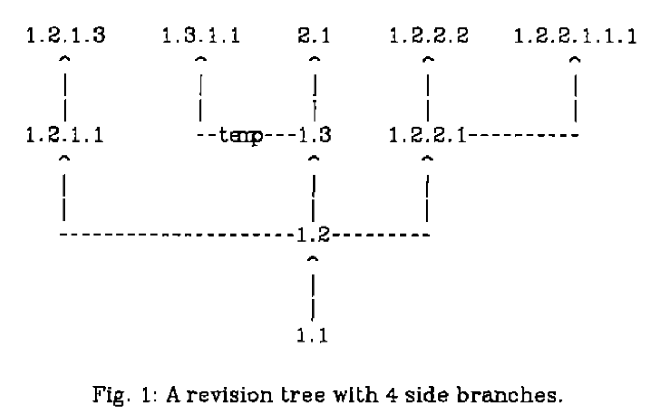
Notes:
There are differences though. The first one is branching. SCCS did not have any concept of branching, but RCS does.
This is an example of branching. We can see that each fork appends another number to the version. You can also give a friendlier label to the branches as an alias. One possible usage for this is to manage releases. You could create a labeled branch for every file and then retrieve every file with that label. SCCS did not provide the ability to provide friendlier labels like that.

Slide 41
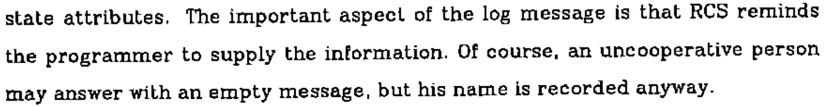
Notes:
Software developers. Providing poor commit messages since the dawn of version control itself.

Slide 42

Wikimedia Commons
Notes:
There were also some auxiliary commands. The most interesting of them let you break locks. Even using RCS on a very small project in college, people forgot to release locks on a regular basis. Interestingly, breaking the lock also sends an email to the person who held the lock.
SCCS also supported breaking locks, but you needed special permissions to do so. In practice, everybody ended up getting these permissions so RCS just got rid of them.

Slide 43
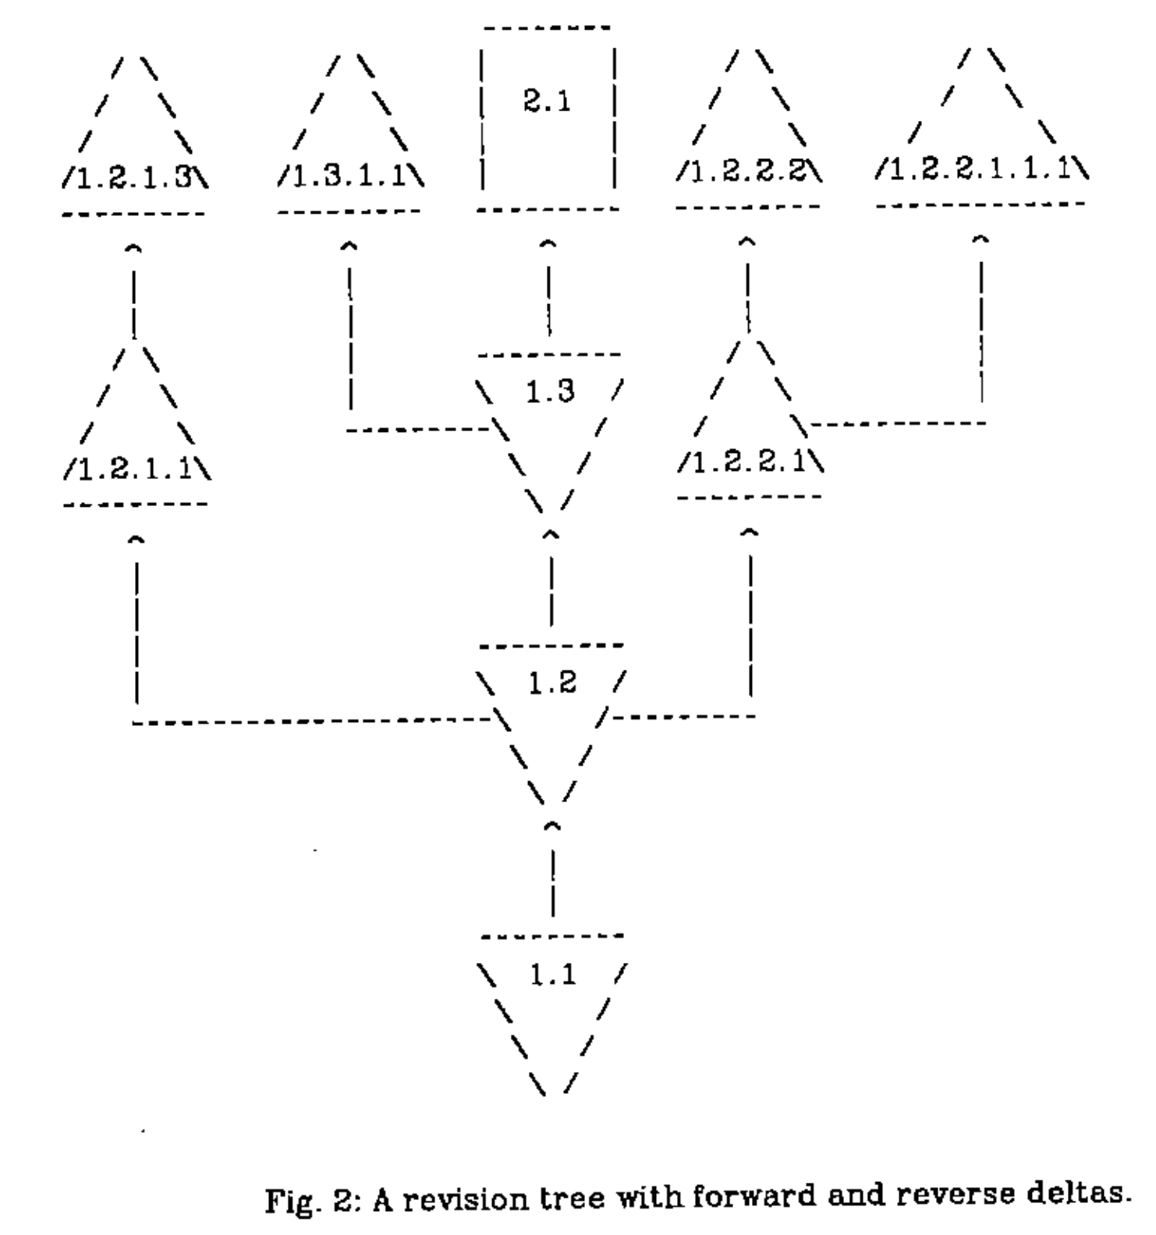
Reverse Deltas
Notes:
RCS departs from SCCS in the way it stores deltas. SCCS stored all the deltas interleaved with each other.
RCS instead uses reverse deltas. The newest revision is stored intact, since that is what you will usually want to check out. If you want to go back one revision, you take the newest revision and apply a reverse delta to go back to that revision and so on to go back to any revision in the history. Adding a new revision is just getting the latest revision and executing diff to get the reverse delta. Then concatenate new revision and the new reverse delta to the already existing deltas. Done.
Of course, the disadvantage here is that going further back in history is more expensive. There is also additional complexity with branching with forward deltas being used on non-trunk branches for storage reasons.

Slide 44
Other Differences with SCCS
MAKE integration
Access controls
Identification
Merging
No Checksums
Notes:
A big advantage of RCS is that it was designed to be easily used with MAKE. SCCS pre-dated MAKE, so it was unnecessarily difficult to integrate the two. The big difference is that the file naming conventions of RCS were designed to be easily used with MAKE.
Tichy also noted that the access control of SCCS could be too strict. I previously mentioned that breaking locks was less restricted.
SCCS also had an identification mechanism that would use markers to insert metadata from the repository into the code on checkout. In practice, it wasn't used because of it's complexity. Tichy's hope was that RCS's system would be much easier to use, but I don't have any information on how true that was.
SCCS provided no mechanism for merges either. RCS branches do support merging, but it's not clear how good that was in practice. Wikipedia implies that teams mostly used locking on a single head branch instead of branching. That seems likely, but I did not attempt to validate that claim at all.
One big thing that RCS was missing (at least in 1982. I didn't check if it was added later), is checksumming. SCCS did this.

Slide 45
Original License
Copyright (C) 1982 by Walter F. Tichy [...] All rights reserved. No part of this software may be sold or distributed in any form or by any means without the prior written permission of the author.
Notes:
RCS is also a bit of case study in the evolution of open source licenses. Through version 3, which was distributed in BSD 4.3, it had the following license.
This license looks crazy today. You needed the explicit written permission of Walter F. Tichy to distribute RCS! This was true until 1989 when the license was altered to

Slide 46
1989 License
Redistribution and use in source and binary forms are permitted provided that the above copyright notice and this paragraph are duplicated in all such forms and that any documentation, advertising materials, and other materials related to such distribution and use acknowledge that the software was developed by Walter Tichy.
Notes:
This is pretty similar to BSD licenses of the day. It's just missing anything about using the Walter Tichy's name to endorse or promote derived products and anything about the software being provided _as is_.
With RCS 4.3 on July 26, 1990 it became distributed by the Free Software Foundation under the GPL.

Slide 47
RCS Today
https://www.gnu.org/software/rcs/
Notes:
Today RCS is a GNU project and easily installable as a package through your package manager of choice. The latest release was 5.9.4 on January 22, 2015. The project is currently maintained by Thien-Thi Nguyen.
Tichy is still an active professor in Germany at the Karlsruhe Institute of Technology in Germany.

Slide 48
Second Generation
Generation | Networking | Operations | Concurrency
First | None | One file a time | Locks
Second | Centralized | Multi-file | Merge before commit
Third | Decentralized | Changesets | Commit before merge
https://ericsink.com/vcbe/html/history_of_version_control.html#ftn.idp96624
Notes:
SCCS and RCS are the pillars of the first generation. The second generation is defined by centralized networking, multi-file operations, and no more file locks for editing. For years, the pillar of the second generation was…
(< 20 mintues)

Slide 49

Notes:
Wrong CVS

Slide 50
Concurrent Versions System
CVS
Notes:
Concurrent Versions System. I'm going to guess this is the point where a lot more people in attendance have used this system.
Personally, my experience with CVS is minimal. The most I’ve ever done with it is checking out projects from SourceForge. I think.

Slide 51

Dick Grune
https://dickgrune.com
Ilana Grune
Notes:
CVS can be said to have two creators. The initial creator was Dick Grune.
Dick Grune was born in 1939 in the Netherlands. He got his PhD in Computer Science in 1982 and then spent the rest of his career teaching in Amsterdam before retiring in 2004.
Dick Grune created the initial version of CVS in 1984-1985...

Slide 52
Origin
I created CVS to be able to cooperate with my students, Erik Baalbergen and Maarten Waage, on the ACK (Amsterdam Compiler Kit) C compiler. The three of us had vastly different schedules (one student was a steady 9-5 worker, the other was irregular, and I could work on the project only in the evenings). Their project ran from July 1984 to August 1985. CVS was initially called cmt, for the obvious reason that it allowed us to commit versions independently.
Dick Grune https://dickgrune.com/Programs/CVS.orig/#History
Notes:
...while working on a student project where all of them had different schedules. It was initially called "cmt" because it allowed all of them commit versions independently.
When this project finished, he cleaned up the shell scripts and renamed it CVS. These shell scripts were just wrappers over RCS. The initial commit of CVS under itself was on November 23, 1985.

Slide 53
Original CVS Scripts
This is CVS, Concurrent Versions System, a front end for RCS. It supports the concurrent and independent use of an RCS directory by several people. We have been using it for half a year now, on various projects. It uses the RCS programs rcs, ci, co, rcsmerge and rlog in such a way that you can do a multi-file commit, etc. It is all shell scripts.
-Dick Grune (June 23, 1986) https://groups.google.com/forum/?hl=en#!original/mod.sources/eqze_AHbIK0/uE90wCq3ui4J
Notes:
He posted the improved scripts to comp.sources.unix on June 23, 1986. You can still find those online today and they still work, assuming you have RCS installed.

Slide 54

Brian Berliner
https://twitter.com/berliner
Notes:
From there, Brian Berliner comes into the picture.
In April 1989, Brian Berliner, along with others at Prisma, took those scripts and ported them to C in roughly two weeks. Prisma was a third-party developer working on the SunOS kernel. Prisma was looking for improved tooling to merge in their changes when Sun would send them an updated version of the kernel. Using CVS, they were able to apply there changes to a new version of the kernel in just two days.
This port turned into the official CVS. His port was released under the GPL and CVS 1.0 became a Free Software Foundation project on November 19, 1990.

Slide 55
CVS II: Parallelizing Software Development
https://docs.freebsd.org/44doc/psd/28.cvs/paper.pdf
Notes:
Berliner summarized his work on CVS while at Prisma in a paper that you can find at this link.

Slide 56
Advances Over RCS
Work with multiple files at once
Client-server architecture
Concurrent edits
Notes:
CVS was the first version control system of what became known as the second generation. All of these advantages are defining characteristics of the second generation.
* The ability to work with multiple files at once. Files are still versioned independently, but you can commit multiple at once. The huge shortcoming of this is that those commits are not atomic. You are not guaranteed that all of them or none of them will succeed. Any number could succeed or fail.
* Client-server architecture. The server contains the centralized repository and clients talk to that repository to check code out, commit code, and other operations. The server is the centralized point of truth and all operations must go through it.
* Concurrent edits. File locks are no longer necessary. Instead, multiple developers may work on a file at once. If developer A commits first, then developer B will be required to pull the new changes in first and resolve conflicts if necessary before they are able to commit their changes. If there are no conflicts, then this process is transparent.

Slide 57
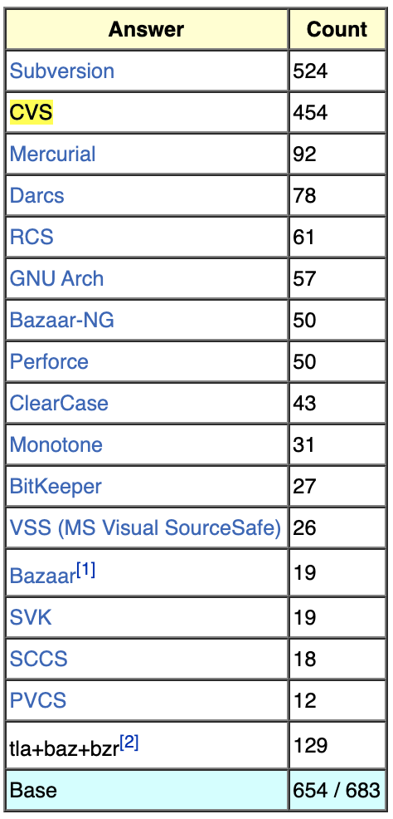
CVS Adoption
http://git.wiki.kernel.org/index.php/GitSurvey2007
Notes:
Unfortunately I was not able to find any hard data on CVS adoption, but I've found enough indirect evidence that I'm willing to state the CVS was the dominant version control system of the 90's.
A 2007 survey by git of it's users found that CVS and SVN were by far the most common version control systems that git users also had experience with. This is not the most representative sample though. An early adopter of git is probably not representative of the average developer.
CVS became the de facto standard for open source development. There were competing paid products, such as Perforce, ClearCase, and Visual SourceSafe, but they never became as ubiquitious as CVS.

Slide 58
CVS Today
Notes:
Today, I would consider CVS to be a dead project. The last release was 1.11.23 on May 8, 2008. There have been some maintenance bug fixes since then, but no releases. The last checkin was on March 30, 2011.
There is a fork called CVSNT that began in 1998 with the initial goal of improving Windows support. Suffice to say, if you wish, you can pay for a commercial version of CVS today.
The real future of CVS was... (SVN)

Slide 59

Notes:
I'm going to guess that a large chunk of those in attendance have use Subversion, especially if you have over 10 years of experience.

Slide 60
Wayback Machine: collab.net (Oct. 16, 2000)
Notes:
The Subversion project was started in 2000 by CollabNet with the explicit goal of making CVS, but better. CollabNet offered a software suite called CollabNet Enterprise Edition (CEE), which included version control. They were using CVS for that part, but the limitations were obvious. Unfortunately, CVS had become so ubiquitous that there wasn't a better open source option.

Slide 61

Karl Fogel
Karl Fogel & Mike Pilato
Notes:
There are few people who are most responsible for the early design and development of the project.
Karl Fogel was the author of Open Source Development with CVS. He had already been discussing a design for a new version control system with Jim Blandy. Those two had previously founded Cyclic Software in 1995 to provide CVS support contracts, so they were well aware of the strengths and weaknesses of CVS.

Slide 62
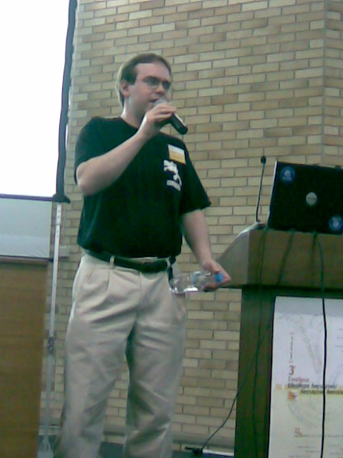
Jim Blandy
Panos Astithas
Notes:
In February 2000, CollabNet reached out to Karl Fogel to ask about his interest in working on a version control system to replace CVS. By coincidence Karl and Jim Blandy were already discussing such a system, Karl immediately joined. Jim was working for Red Hat Software at the time and convinced them to essentially donate him for an indefinite period of time to work on the project. CollabNet also hired Ben Collins-Sussman at this time.

Slide 63

Ben Collins-Sussman
https://www.red-bean.com/sussman/
Notes:
Their initial goals were simple. Jim already had a name, Subversion, and a basic design for the data store from his previous musings with Karl. They didn't want to break any new ground, they just wanted to fix CVS. They wanted to match CVS's features and development model, but avoid the big flaws. It didn't need to be a drop-in replacement, but it needed to feel very familiar to a CVS user to make the transition relatively painless.
Subversion became self-hosting on August 31, 2001, after 14 months of development. Up until this point the code was actually managed with CVS.

Slide 64
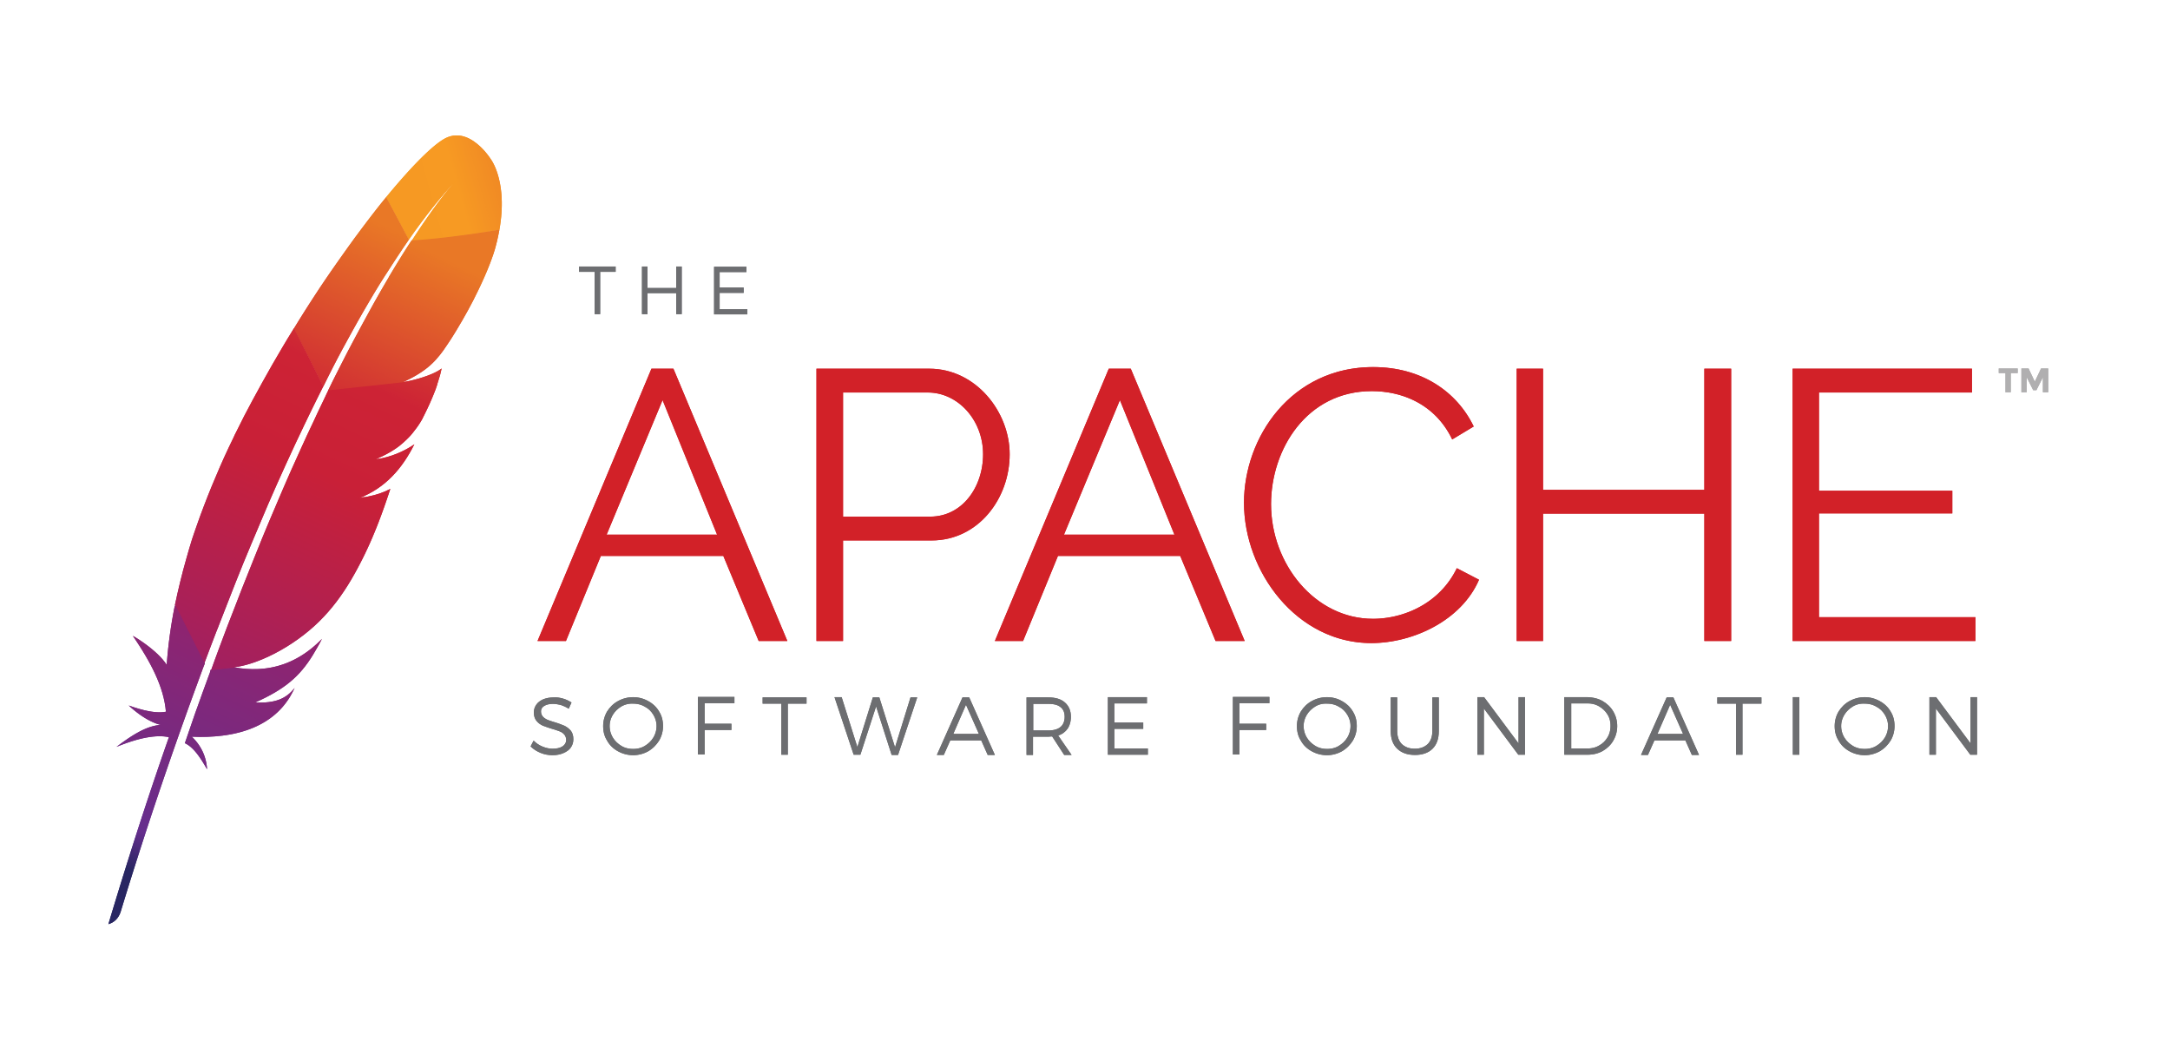
Notes:
In November 2009, Subversion was accepted into Apache Incubator. Things moved quickly and it became a top-level Apache project on Feburary 17, 2010. It remains an Apache project to this day.

Slide 65

Brian Behlendorf
Faces of Open Source / Peter Adams
Notes:
One major factor in Subversion becoming an Apache project was Brian Behlendorf. He was one of the founders of CollabNet, along with

Slide 66

Tim O’Reilly
Faces of Open Source / Peter Adams
Notes:
...Tim O'Reilly (yes, the one you're thinking of) and Bill Portelli. Behlendorf is best known for being the primary developer of the Apache Web Server and founded the Apache Group, which became the Apache Software Foundation.

Slide 67
Advantages over CVS
Atomic commits
Directories, renames, and moves
Local operations
Branches and tags
Metadata
Binary files
Notes:
The entire goal of Subversion was to create a fixed version of CVS and they succeeded in that.
* The entire repo is revisioned, not individual files. Getting the repository status at a single point in time is just one version number. This also gives you atomic commits.
* Directories are versioned as well. You can run svn commands on them.
* Support for renames and moves.
* Limited support for local operations, such as the status of changes you have made, a diff of your changes, and reverting your changes.
* Branches and tags are just ordinary directories within the filesystem.
* Support for arbitrary metadata on files and directories with _propget_ and _propset_
* Better support for binary files. It stores a binary diff instead of full copies like CVS does.

Slide 68
Notes:
Subversion 1.0 was released on February 23, 2004. I was not able to find any hard adoption numbers for Subversion, but Google Trends shows Subversion coming out ahead relatively quickly after the 1.0 release.
https://trends.google.com/trends/explore?date=all&q=%2Fm%2F012ct9,%2Fm%2F09d6g&hl=en-US&tz=&tz=

Slide 69
Notes:
Subversion has definitely fallen out of favor today but remains the most widely used centralized version control system. It's still actively developed. Version 1.13 was released on October 30, 2019.
Stepping back a bit though, I think it’s important to note that Subversion is the first “modern” Open Source VCS developed that way from the start. SCCS was developed at Bell Labs and was internal project for years. RCS had Walter F. Tichy’s own license. CVS was a bunch of scripts dumped into USENET. SVN was the first VCS developed in the open in the modern sense of the OSI approved definition of open source.

Slide 70
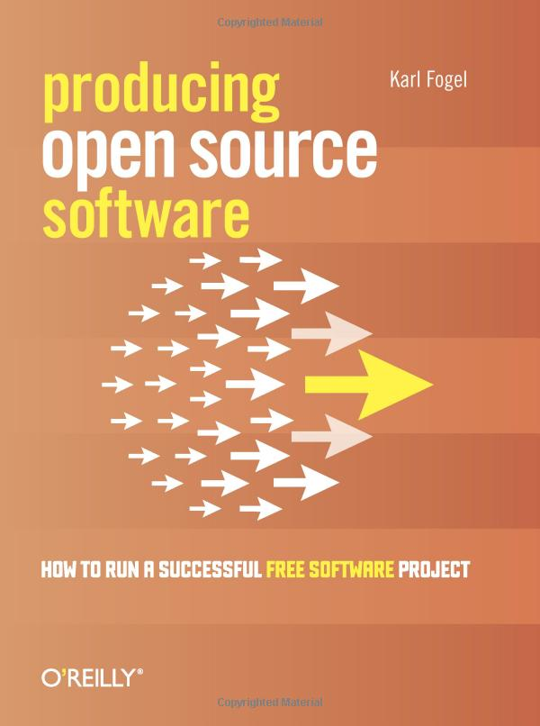
Karl Fogel
https://questioncopyright.org/
https://opentechstrategies.com/
Notes:
Karl Fogel would go on to write _Producing Open Source Software: How to Run a Sucessful Free Software Project_. He would draw on his experience with Subversion a lot during the book. He currently is a partner at Open Tech Strategies, LLC, where he helps organizations launch and participate in open source projects.
In addition, he founded QuestionCopyright.org, a non-profit that advocates for copyright reform.

Slide 71
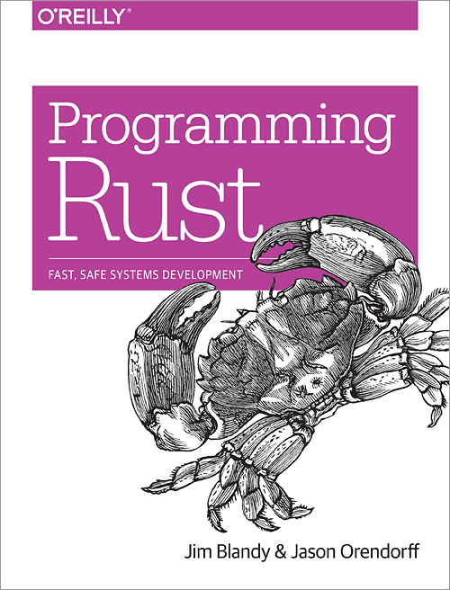
Jim Blandy
Mozilla
GNU Emacs
GNU Guile
GDB
Notes:
Today, Jim Blandy works for Mozilla. He is one of the authors of Programming Rust. In addition, he has also been the maintainer of GNU Emacs, GNU Guile, and GDB.

Slide 72
Ben Collins-Sussman
Subversion on Google BigTable
Google Code
https://www.red-bean.com/sussman/
Notes:
Ben Collins-Sussman has gone on to co-found Google's engineering office in Chicago. He ported Subversion to use Google's BigTable as storage and was instrumental in the launch of Google Code. Today he manages teams in charge of Google's search's overall latency and speed.
(~ 28 mintues)

Slide 73
Third Generation
Generation | Networking | Operations | Concurrency
First | None | One file a time | Locks
Second | Centralized | Multi-file | Merge before commit
Third | Decentralized | Changesets | Commit before merge
https://ericsink.com/vcbe/html/history_of_version_control.html#ftn.idp96624
Notes:
Subversion was basically the end of the second generation, but even before it’s creation the third generation was starting. The Subversion project started in 2000, but…

Slide 74
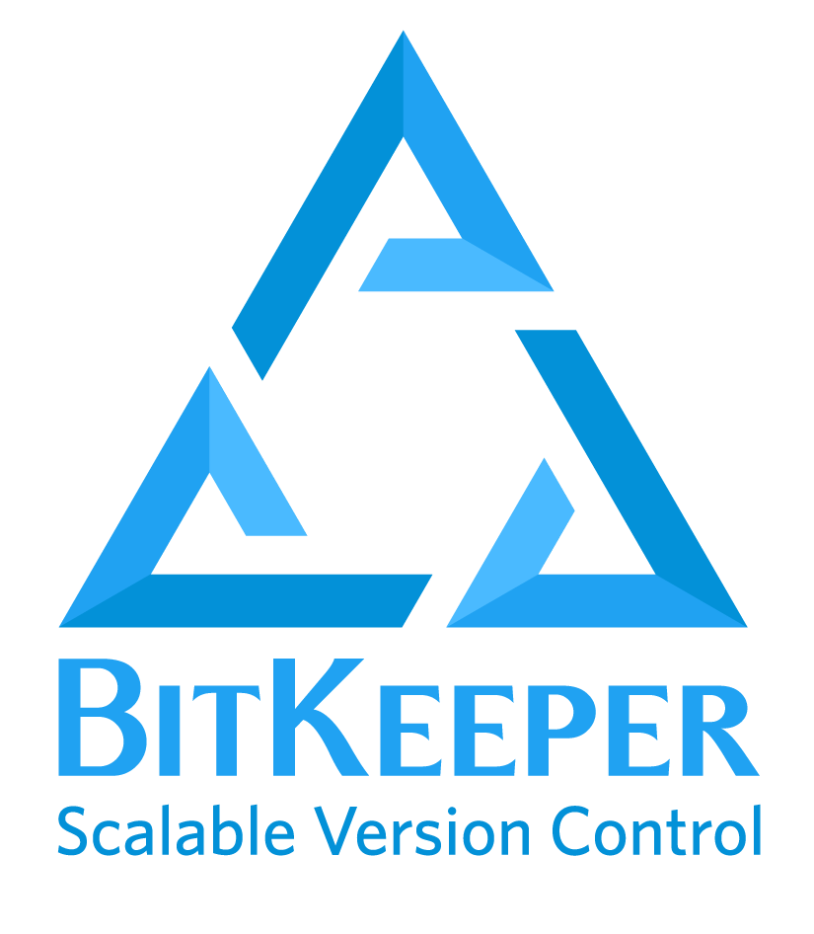
Notes:
…BitKeeper started before that.
I have no personal experience with this tool, but, as we'll see, it's an incredibly important version control system.
Now, I know I said we were not going to cover commercial version control options, but the history of git cannot be separated from BitKeeper. BitKeeper is probably the most important commercial version control system ever. Almost certainly not the most widely used, but the most important.

Slide 75

Larry McVoy
Founder of BitMover
Wikimedia Commons / Eugene Zelenko
Notes:
There isn't a lot of information available about the history of BitKeeper. Most of what I was able to find comes from their now open-sourced repository. Their repository mentions that Larry McVoy wrote a semi-distributed VCS while working at Sun. That was later turned into Teamware. You can also see the complete history of the project all the way back to when it became self hosting in March 1999.
BitKeeper itself was a product of BitMover, which as far as I can tell, was created solely to create BitKeeper.

Slide 76
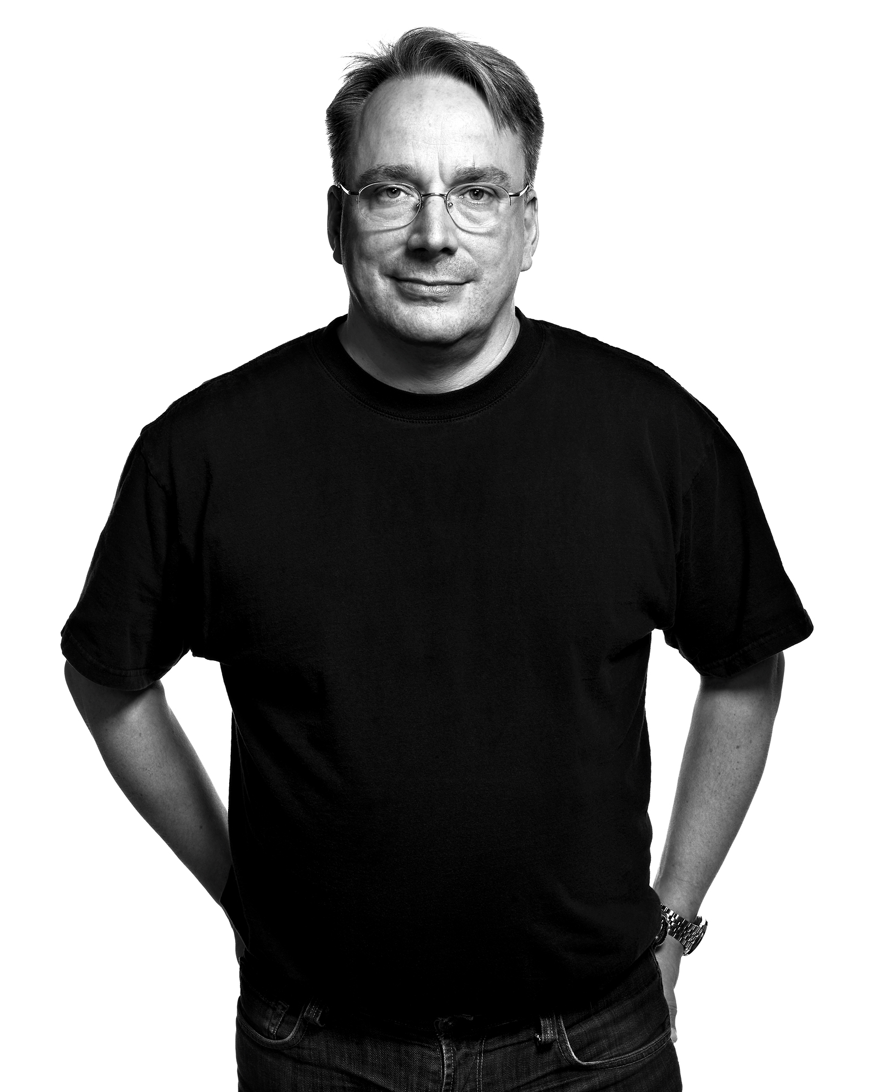
Linus Doesn’t Scale
Faces of Open Source / Peter Adams
Notes:
On Sept. 30 1998 Larry McVoy sent a message to the kernel mailing list outlining a proposal for how to solve the Linus scaling problem.
At the time, Linux was experiencing growing pains. Linus was a bottleneck for getting patches merged into the kernel. The proposed solution was a DVCS that would allow others to test and tweak patches in a very transparent manner as they made their way towards Linus through his circle of trust. This DVCS would be developed by Larry's company, BitMover.

Slide 77

http://www.bitmover.com/bitsccs/
Notes:
In that message Larry also linked to a page about BitSCCS, which is fascinating. It's a reimplementation of SCCS that also adds a number of new features. It served as the underpinnings of BitKeeper.
Let’s step back and appreciate this though. The core of the first 3rd generation version control system was a reimplementation of the very first version control system. That’s amazing.
In a harbinger of things to come, there is a licensing section that highlights that it will be free as in beer for free software development, but paid for commercial development. As of October 1, 1998, Larry estimated that he has lost $118,000 from quitting his job to work on this project with the explicit goal of helping Linus.
BitKeeper became self-hosting in March 1999. Early access betas became available in May 1999 and the first public release on May 4, 2000.

Slide 78
Licensing Issues
Free vs. Commercial
Notes:
But BitKeeper's licensing was... problematic. It tried to straddle the line between the free and commercial worlds. This kind of setup is fairly common today. BitKeeper compounded it though with two clauses
1. You could not reverse engineer anything related to BitKeeper for any reason.
2. You could not participate in the development of a competing tool. You couldn't contribute to any other VCS if you used BitKeeper without violating the license. You had to wait another year after your use of BitKeeper ended to start contributing to anything.

Slide 79

Notes:
In 2002, BitKeeper was adopted by the Linux kernel. This decision was highly controversial. Torvalds and other core developers accepted the free license, but other core developers did not. This tension would come to a head in 2005.

Slide 80

Andrew “Tridge” Tridgell
Wikimedia Commons / Singa Kuttty sivasakthi
Notes:
In April 2005, BitMover announced that it would be revoking this license because Andrew Tridgell (pronunciation?) had started reverse engineering the wire protocol to develop a third-party BitKeeper client. Larry McVoy said this violated the license and a lot of heated arguments ensued, with Torvalds in the middle.

Slide 81

Notes:
Tridge had also been instrumental in reverse engineering SMB to create Samba, so this was very on brand for him. (He had also co-developed rsync for his PhD dissertation.)
Tridgell argued that he had never bought or owned a BitKeeper license. Thus, he had never agreed to its license and was not bound by it's restrictions around reverse engineering. It was ethical reverse engineering, just like Samba. Tridgell claimed that all he had done was telneted into a BitKeeper server and typed _help_. His goal was to provide features around metadata and comparing past revisions, features that were only available in the commercial version of BitKeeper.
In the end a very angry Torvalds was left to find a replacement for BitKeeper. We'll come back to that. (Foreshadowing!)

Slide 82
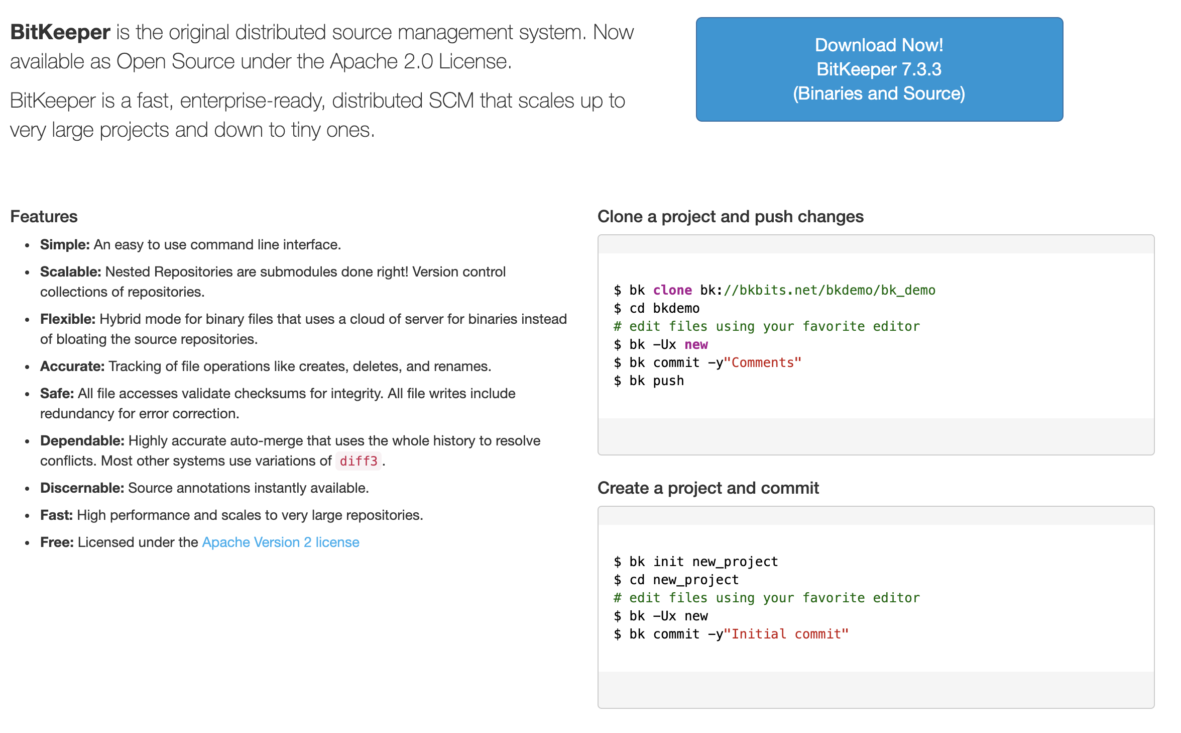
https://www.bitkeeper.org/
Notes:
BitKeeper was open sourced under Apache 2.0 on May 9, 2016 with version 7.2ce (CE = community edition), in what many interpreted as a belated attempt for relevance. Like just about every version control system in the wake of git, by 2016 BitKeeper was mostly a forgotten relic. It was mostly remembered for its role in the creation of git.
The current stable release is 7.3.3 on Dec. 29, 2018. The public repository on bkbits.net has no commits since. It's not clear what the development status of the product is.

Slide 83

Wikimedia Commons / tommybuddy
Notes:
We’re going to go rapid fire here now. The stage has been set. Larry McVoy has rescinded the BitKeeper license for Linux kernel development and Linus Torvalds is trying to figure out what to do. His disdain for CVS is legendary. He views SVN as a bit better, but still flawed in the same fundamental ways that CVS is. He wants a distributed version control system, so he starts evaluating the existing options, which brings us to…
(< 33 mintues)

Slide 84

Wikimedia Commons / Graydon Hoare
Notes:
The initial release was on April 6, 2003, but I wasn't able to find much information besides that. The initial creator of monotone was Graydon Hoare, who would later go on to create...

Slide 85
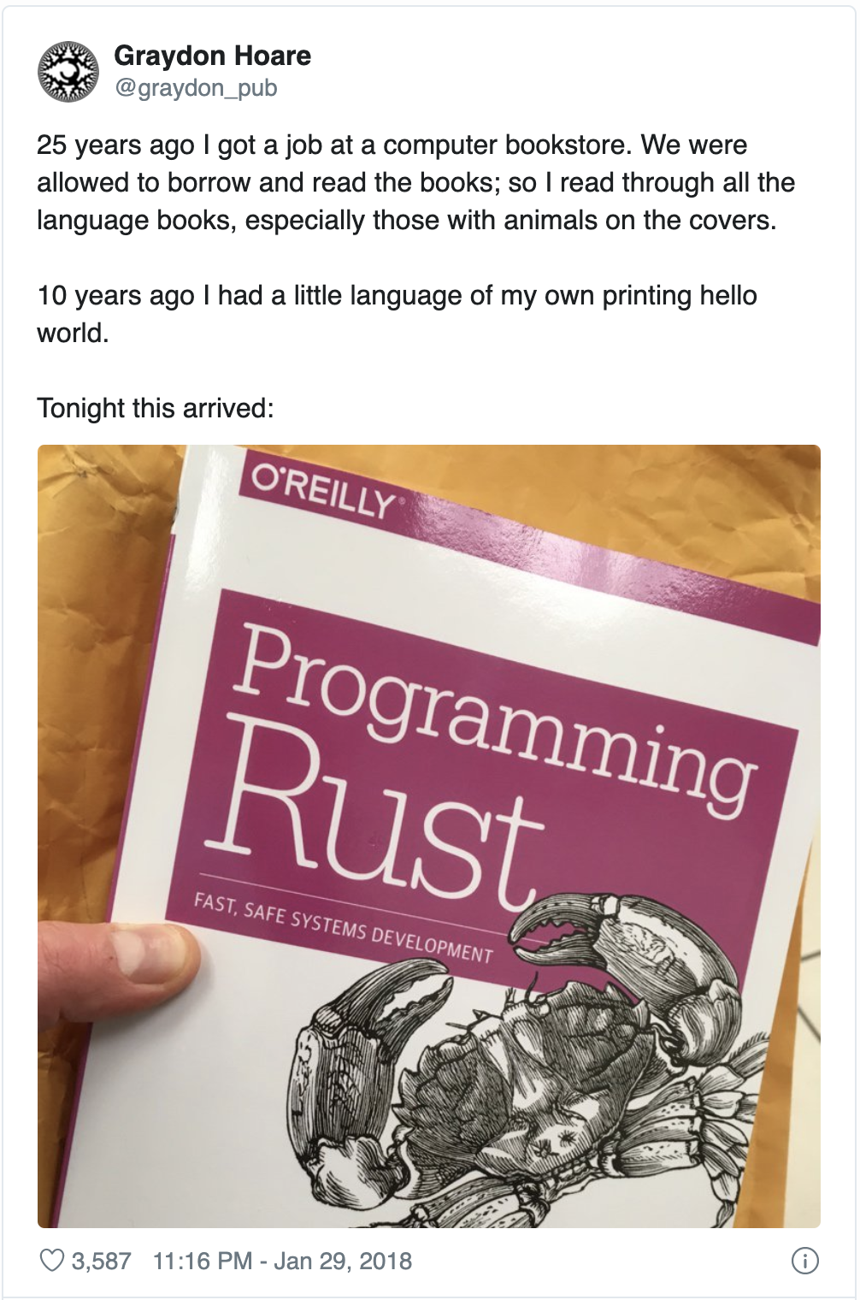
Twitter
Notes:
He's the initial creator of Rust!
And remember that Jim Blandy, one of the creators of Subversion is the author of Programming Rust. It’s kind of amazing how interconnected some of these things get.
The name comes from Graydon's desire to pursue the concept of "monotonically increasing test coverage." The basic idea was to automatically maintain a repository of code that always passes all the tests. Monotone was eclipsed by git though and never got there.

Slide 86
Evaluation for Linux
SHA-1
Performance
Notes:
Torvalds liked Monotone's usage of SHA-1 files to identity objects.
Performance. The project placed a higher emphasis on on integrity instead of performance. This was magnified when Torvald's was looking at monotone as a replacement for BitKeeper. The 0.17 release had just added a lot of sanity checks that severely degraded performance. This is when Torvalds looked at it. Performance was never the best and may never have been good enough for Linux, but the timing was very unfortunate.

Slide 87
Monotone Today
https://www.monotone.ca/
Notes:
Monotone never caught on. It's only real moment in the sun came from Linus Torvalds mentioning that he looked at it before writing git. He discarded it because of the poor performance.
The last release was 1.1 on May 4, 2014. That was over six years ago. Looking through the mailing list, that release seems to have been a last gasp just to package together various patches that that distro packages were accumulating. There have been no commits since, although it's hard to tell because the official source repository seems to be offline.

Slide 88

Notes:
One other system that Torvalds looked at was Darcs.
Personally, I used Darcs from 2010 - 2012 while working at a small consulting company.

Slide 89
Darcs
David’s
Advanced
Revision
Control
System
Notes:
David Roundy is creator of Darcs. His little pet project originally stood for David’s Advanced Revision Control System, but he later changed to what he felt was the less embarrassing backronym of Darcs: Advanced Revision Control System.

Slide 90

David Roundy
http://physics.oregonstate.edu/~roundyd/people.html
Notes:
David’s background is a bit different then what you would expect from someone creating a version control system. He received his Ph.D. in physics from U.C. Berkeley in 2001.
While doing post-doctoral work, he was also working on a cross-platform online bridge game called aBridge. He was using CVS on SourceForge, but wasn't happy with it. Subversion was really new at the time, but Roundy was interested in the idea of a distributed system, so he started looking into Arch.

Slide 91

Wikimedia Commons / Free Software Foundation
Notes:
Arch was GNU's distributed version control system. The briefest of histories is that it was started in 2001 and had petered out by 2008.
The important thing is that it had the most adorable logo.

Slide 92
David Roundy
http://physics.oregonstate.edu/~roundyd/people.html
Notes:
In June 2002 he got involved in discussions about creating a new patch format for arch, but it became clear that his proposal would never be incorporated. He found the ideas interesting though, started playing around with them, and, behold, Darcs was born.
The initial version of Darcs was written during the summer of 2002 in C++. However, there was a lot of experimentation as Roundy figured out what exactly he was trying to implement, so by that autumn he had a very solid mass of bugs that was difficult to debug.

Slide 93

(Haskell)
Wikimedia Commons
Notes:
When you have a side project you should always make it more complicated by re-writing in a language you barely know. Around that time he had also started looking into Haskell, so... guess what happened next?
The first public release of darcs was v0.9.3 on April 3, 2003. Windows support was added that summer.
In April 2008, Darcs 2.0 was released. It "introduced a more robust repository format, as well as a new patch semantics called "darcs-2", aimed at minimizing exponential merge issues.” The exponential merge issues were a performance issue that could happen with certain conflicts.

Slide 94
Strengths
Weaknesses
Patch theory
Interactive CLI
Performance
Interactive CLI
Notes:
By far the most interesting part of Darcs is its theory of patches. In Darcs, a repository is a set of patches that are not necessarily ordered with respect to other patches. Darcs automatically calculates whether patches can be reordered and how it should be done. If your patches modify independent parts of the code, then they are not dependent upon each other and can be applied in any order. This makes it easy to merge individual patches. Since Darcs calculates the dependencies between them, it will also tell you what dependent patches need merged as well.
If you are interested in learning more about patch theory, then I highly recommend checking out the theory section on the official Darcs site. It has a lot of good examples of what Darcs tries to do and how.
The other big advantage of Darcs is the CLI. Who hear knows the ins and outs of the git CLI? Definitely not me. I always have to reference the docs once I get off my happy path. Darcs on the other hand has a very explicit goal of an easy to use, interactive CLI.
Who here uses _git add -i_? That type of interactive command is the default it darcs. A lot of time and care has been spent to make it feel usable and intuitive to mere mortals.

Slide 95
Darcs Today
Notes:
Today, Darcs is a very niche version control system. It's still actively developed, but at a pretty slow pace. 2.14.2 came out in January 2019 and when I checked on December 17, 2019, there hadn't been a single commit since October 2, 2019.
My understanding is that it is more common in the Haskell community, which makes sense since it's written Haskell. But even the Darcs diehards have mostly accepted that git has become The One True VCS. Even way back in 2011 there was talk in the community about Haskell projects starting to move away from Darcs to git.

Slide 96
Notes:
We’ve finally made it. It’s time to talk about git.
The early history of git is tightly bound to the history of Linux version control. As we already discussed, in 2002 Linus decided to adopt BitKeeper for kernel development. This all boiled over in 2005.
(<39 minutes)

Slide 97
BitKeeper Replacement Criteria
A patch should take no more than three seconds to apply.
Take CVS as an example of what not to do; if in doubt, make the exact opposite decision.
Support a distributed, Bitkeeper-like workflow
Include very strong safeguards against corruption, either accidental or malicious.
Notes:
This left Torvalds and the wider Linux development community in a tough place. Torvalds set the following criteria for any system that would replace BitKeeper.
Torvalds's disdain for CVS was widely known. He had even gone so far as to say that kernel development would revert back to using no version control at all instead of using CVS. He spent a bit of time evaluating monotone and darcs, but ended up rejecting both for performance reasons.

Slide 98
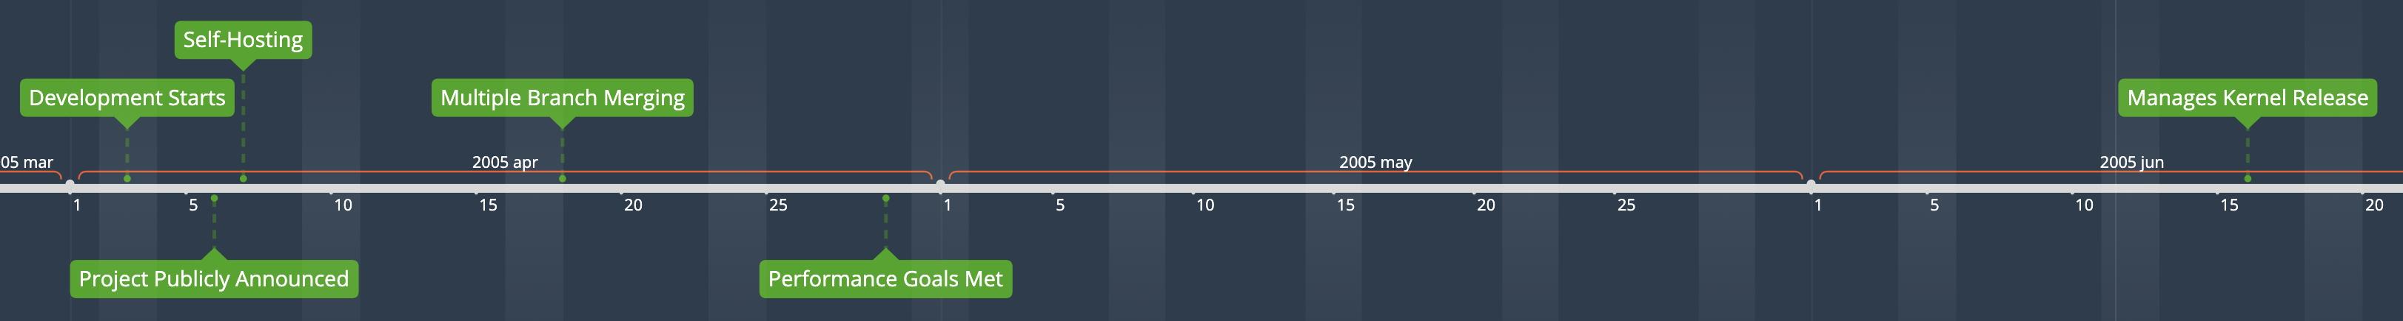
Git Development Timeline
Notes:
Following the release of kernel v2.6.12-rc2, Torvalds was able to start dedicating all of his time to the first version of git. Development was rapid.
* April 3, 2005: Development begins
* April 6, 2005: Torvalds announces the project
* April 7, 2005: Git becomes self-hosting. The README also contains multiple meanings of the name, although Linus seems to have decided that the true origin is the British slang "git", which means "a silly, incompetent, stupid, annoying, or childish person". He claims that he's now been arrogant enough to name two projects after himself, Linux and git.
* April 18, 2005: First merge of multiple branches
* April 29, 2005: Performance goals met. Recorded 6.7 patches per second to the Linux kernel tree
* June 16, 2005: Git managed the kernel 2.6.12 release.

Slide 99

Junio Hamano
Faces of Open Source / Peter Adams
Notes:
Torvalds turned over maintenance to Junio Hamano on July 26, 2005. Hamano had been a major contributor.
1.0 was released on December 21, 2005. Hamano remains the project maintainer to this day.

Slide 100

Usability
Wikimedia Commons / Gael Mace
Notes:
In the early days, git was notorious for being difficult to use. Linus had developed a system designed specifically for his workflow around merging patches into the Linux kernel. There was little to no separation between the internals and the porcelain, which is the commands exposed to users.
It's taken many years of work to make the project more usable. In a 2007 talk at Google, Torvalds mentioned that he thought that git was mostly usable for other projects at that point.

Slide 101
Notes:
Git had a huge advantage compared to any other VCS in history. The highly visible conflict over BitKeeper, on the most highly visible open source project in the world, with the most famous open source developer in the world as a central figure gave it an enormous amount of visibility. Git was then able to capitalize on that visibility by rapidly creating an initial version and using it to manage a release of the Linux kernel.
We can see on this Google Trends graph that buzz around git surpassed SVN right around 2011.
https://trends.google.com/trends/explore?date=2005-04-01%202019-12-23&q=%2Fm%2F05vqwg,%2Fm%2F08441_,%2Fm%2F012ct9,%2Fm%2F09d6g

Slide 102
Eclipse Community Survey (2009 – 2014)
Notes:
This graph shows Git adoption vs. SVN from 2009 – 2014 in the Eclipse Community Survey. You can see that in 2014, git surpassed SVN.
By 2018 the Stack Overflow community survey showed that almost 90% of 74,000 developers surveyed preferred to use git. The results were so lopsided that the 2019 survey dropped the question completely.

Slide 103
Influences
Notes:
This isn't a technical talk, so I'm not going to dive into any details of git internals, but I think that it is very important to point out how unique git is compared to what came before it and why.

Slide 104
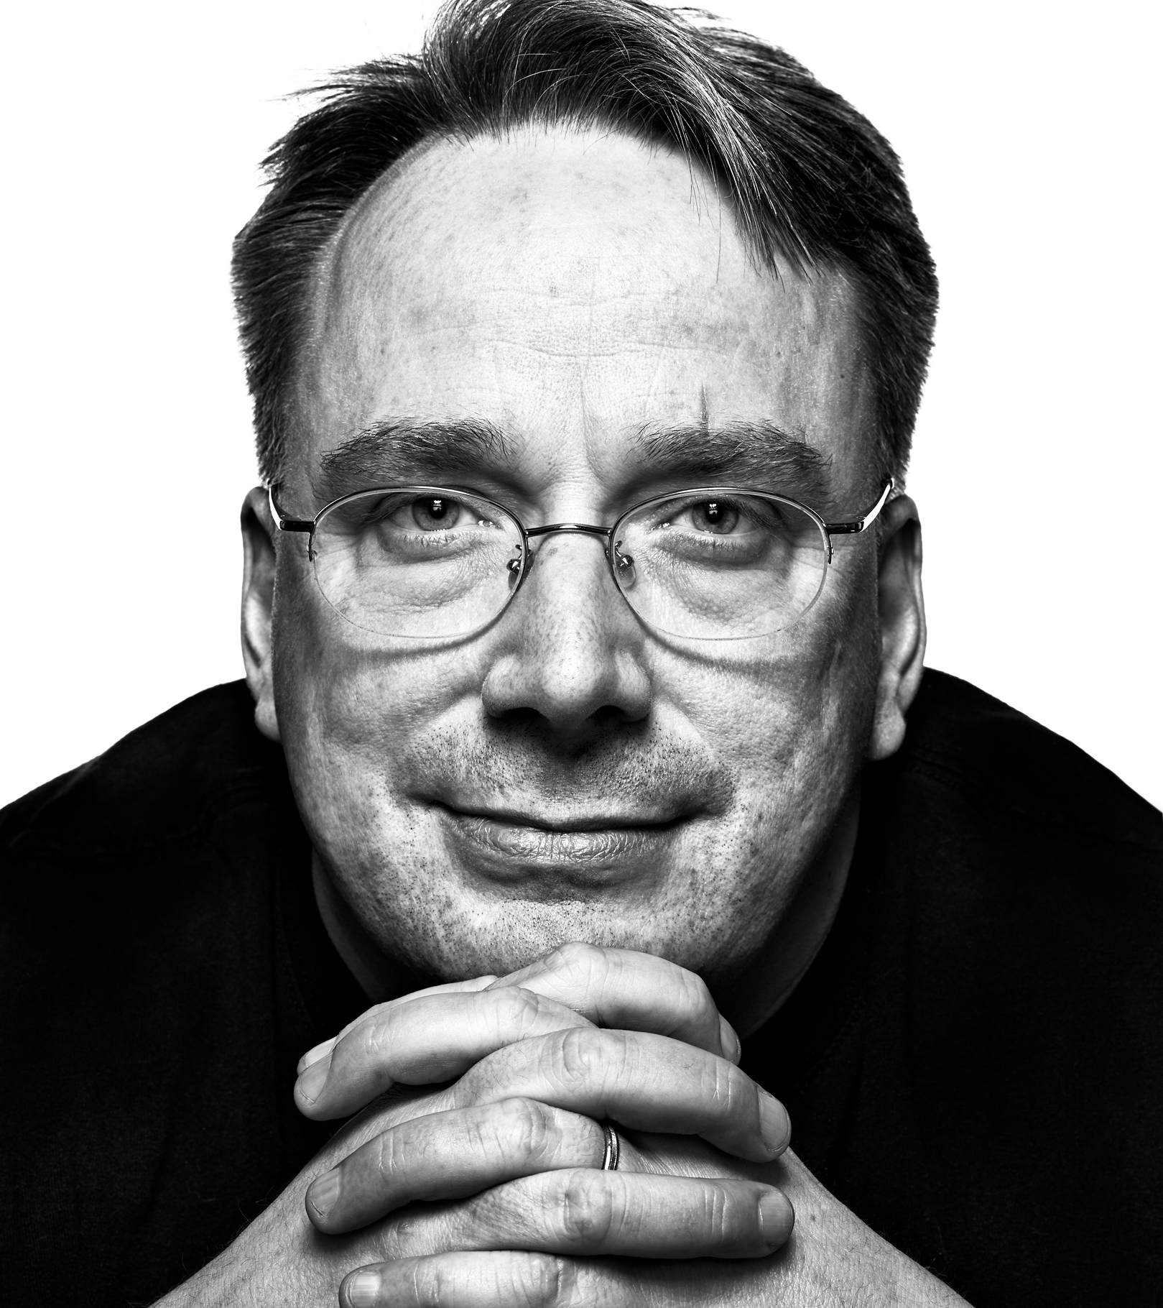
Linus Torvalds
Experience managing Linux
File system performance
Urgency
Faces of Open Source / Peter Adams
Notes:
There are three primary constraints/influences that had a large effect on the initial design
* Torvalds's experience maintaining a large distributed development project.
* Torvalds's intimate knowledge of file system performance. This is what he knew, so building a VCS around the file system instead of a DB was very natural for him.
* The urgent needs to have a working project in short order. Torvalds gave himself a two week deadline for the initial version of git.

Slide 105
When I did git, one of the things that actually helped me was that I was consciously trying to not do a BK clone. I wanted to do the same things that BK did, but I very much did not want to do them the way BK did them. I respect Larry too much, and I didn't want there to be any question about git being just a "clone".
So a lot of the git design ended up very much trying to avoid old designs on purpose, and I think that really helped. The fact that I didn't have a background in SCM's, and that I thought all the weaves etc were confusing, meant that I instead went for a radically different way of doing things.
And I'm 100% convinced that "radically different" was the right thing to do. That was what allowed git to really soar. A lot of the good things in git come exactly from the fact that git does not do things like most traditional SCM's do. But BK should still get a lot of credit, because it was what taught me (and a lot of other people) what being "distributed" really meant.
- Linus Torvalds (Git mailing list 2006-10-19)
Notes:
This is a post from Torvalds in October 2006 to the git mailing list explaining how BitKeeper influenced him to NOT make a BitKeeper clone. He respected McVoy’s work with BitKeeper too much. Torvalds went out of his way to avoid old designs.
I would highly encourage you to check out the entire post if you can. The fact that almost the entire history of git is available in both git and mailing list discussions is really unique. It’s a stark contrast to how difficult it was to find information about the early history of other version control systems.

Slide 106
And finally, Monotone for the "everything is an object named by its SHA1" model, which to some degree is perhaps the central - or at least the most obvious - part of git. It largely was designed really just to be the "backing store" for the "cache", and to not be _that_ important. That also explains why I didn't worry too much about disk usage etc initially: the object store wasn't even the most important part, and I envisioned just moving old objects that weren't needed into some "backup storage" kind of thing.
- Linus Torvalds (Git mailing list 2006-05-05)
Notes:
The biggest contribution from monotone is the idea that every object has a corresponding hash. Torvalds was already planning on using hashes for the history, but monotone took it further. Every object had a hash. This became a central part of git as well.

Slide 107
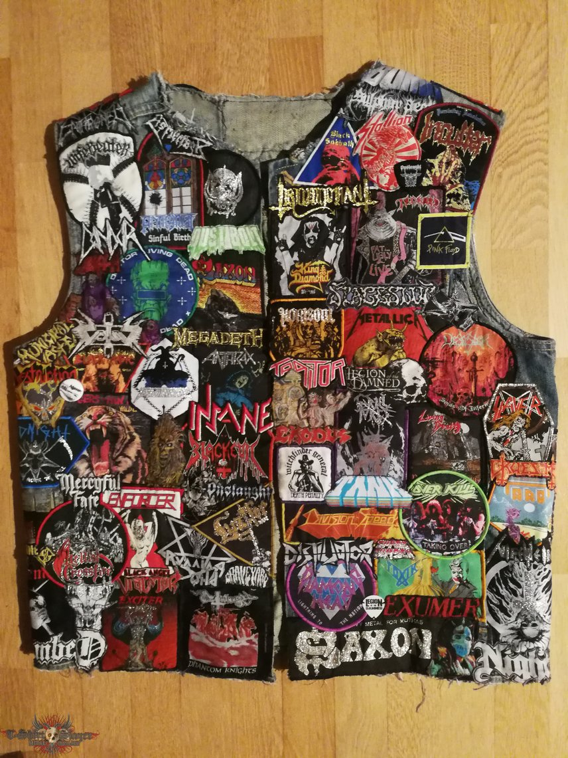
One of the suggestions that I tried to push as an acceptable middle ground was to make a "generic" BK repository export format, so that people who didn't want to use BK could still get all the information, and not in a broken format like CVS (yes, CVS makes sense as an interchange format, since _everybody_ speaks CVS, but it's a horrible, horrible, horrible format from any technical standpoint).
My example export format was really a strange mixture of patches with parenthood information, where the history information was described with hashes (MD5 rather than SHA1, but that was just an implementation thing, and mostly because BK used MD5 sums). Not something really useful as a real SCM, but it wasn't designed for that - it was just meant to be a useful and unambiguous interoperability format.
- Linus Torvalds (Git mailing list 2006-05-05)
tshirtslayer.com / Blade of Tokyo
Notes:
While trying to come up with a compromise between Tridgell and McVoy, Torvalds had proposed a generic export format from BitKeeper. The format was a series of patches with parenthood information. (See https://marc.info/?l=git&m=114685143200012)
When no compromise could be reached and Torvalds was searching for a replacement for BitKeeper, this idea was already in his head. If nothing else could be found, he would just go back to lists of patches rather than use CVS.
He eventually extended the series of patches idea to include a "cache" since rebuilding the current state from the beginning was expensive. Conceptually this became the git "index" file and working tree.

Slide 108
Git Today
https://git-scm.com/

Slide 109

(It won)
Wikimedia Comons / Elegant Themes
Notes:
It won. That's it.

Slide 110

Notes:
I don’t have time to dive into it, but Git wasn't the only version control system to emerge from the ashes of the BitKeeper fallout. There was also Mercurial. The extremely short versions is that it was announced about two weeks after Git and that was two weeks too late.

Slide 111
to initially be as simple (and thereby hackable) as possible
to be as scalable as possible
to be memory, disk, and bandwidth efficient
to be able to do "clone/branch and pull/sync" style development
- Matt Mackall (Kernel mailing list 2005-04-20)
Initial Goals
Notes:
The early history of Mercurial is tightly linked to BitKeeper and git.
Matt Mackall first announced Mercurial on April 19, 2005, thirteen days after Torvalds announced git. His initial goals were (https://lkml.org/lkml/2005/4/20/45)
- to initially be as simple (and thereby hackable) as possible
- to be as scalable as possible
- to be memory, disk, and bandwidth efficient
- to be able to do "clone/branch and pull/sync" style development

Slide 112
Git vs. Mercurial
Notes:
The comparisons to git are inevitable. With regards to performance, git has generally always been faster for most operations, but Mercurial is close behind it. Both of them generally blow away any other DVCS.
Mercurial is written mostly in Python, with some sections written in C/C++ for performance reasons. Because of the choice to use Python, Mercurial was cross-platform from day one. It took quite some time for git to become usable across platforms, especially Windows.
Mercurial prioritized a very usable CLI from day one. This is a big contrast to git, which for years had a reputation for being unusable by mere mortals.
The trade off was that Mercurial lacked many features that git had. For example, Mercurial did not initially support branches. The preferred workflow was to just create another clone of the repo.
The Mercurial team also argued against operations that allowed users to change history, such as rebase. Their philosophy was that that a project's history should be complete and fixed.
Similar to git, Mercurial also took design inspiration from monotone in it's use of hashes.

Slide 113
Mercurial Today

Slide 114
Notes:
Matt Mackall stepped down as project lead in late 2016. Today he works at Facebook, which uses Mercurial. Mozilla is also a notable user of Mercurial.
Facebook is also working on a Mercurial source control server written in Rust called Mononoke.
The 2018 Stack Overflow Developer Survey showed that almost 90% of developers use git, but only 3% use Mercurial.
It is still under active development though. Version 5.2 was released on Nov. 5, 2019.
I think there definitely is an alternate reality where Mercurial won, but all the factors that have led to such wide adoption of git all worked against Mercurial.

Slide 116

What Comes Next?
David Revoy / Blender Foundation
Notes:
Wow. That was a lot.
In 1972 we got the first version control system in SCCS. In 1985 we got the first iteration of CVS, kicking off the second generation of version control systems. Then, in 2005 we got git, which kicked the third generation into high gear, bringing distributed version control systems to the mainstream. But 2005 was a long time ago now. Is there anything else on the horizon that could replace git?
In just about every other area of developer tooling there are new options created every year. Sadly, after the explosion in DVCS's in the mid-2000s, there isn't much to talk about.

Slide 117

Pijul
https://pijul.org/
Wikimedia Commons / Hans Hillewaert
Notes:
Pijul can be thought of as a newer version of Darcs that attempts to fix its performance issues. It is written in Rust and has a slightly updated version of Darcs's patch theory.
I haven't used Pijul myself, but I would be excited to try it on a collaborative project. I liked Darcs. A version with better performance and other improvements sounds like something really cool to try. Easier to use cherry picking sounds great too.
Pijul is still considered beta quality, so use at your own risk.
Pijul is the mexican name of Crotophaga sulcirostris, a bird known to do collaborative nest building.

Slide 118

https://www.plasticscm.com/
Notes:
I’m really scratching the bottom of the barrel trying to find something interesting in our git-dominated world.
Plastic is a commercial tool that was first released in 2006. It has a couple of differentiating features.
* Focus on the game industry. This wasn't the original focus, but a shift as git continued to eat the world. One of git's weaknesses is binary assets, so the games industry is one area where git has not achieved widespread adoption. Focusing on a niche is one way that a new VCS could gain a foothold.
* Language awareness allows for history of specific methods/functions instead of just lines. This seems really cool and something I would love to play with.

Slide 119















Why?
Octodex / GitHub
Notes:
Why aren’t there more new version control systems coming to supplant git?
GitHub, not git, is the primary reason that no viable replacement for git is on the horizon. Previous generations of version control didn't have to deal with such a strong network effect when replacing the old. Everything works with GitHub. All new open source projects are hosted there by default. An entire DevOps industry has sprung up around it. Realistically, any new version control system would have to be adopted by GitHub to gain significant traction.
We obviously don't have adoption numbers for the entire history of version control, but I feel confident in saying that no other version control system has ever had such numbers. The market was fragmented across many open source and commercial options before.
Pijul is the only new VCS I could find with any buzz around it and even that is minimal. I can't decide if this is a depressing note to end on or not, but that's the current state.

Slide 120

Brian Meeker
Website: https://brianmeeker.me/
Twitter: @CuriousCurmudge
Slides: https://github.com/CuriousCurmudgeon/history_of_vcs
Notes:
And with that, I would like to thank all for sticking around to the end of the day. The slides are of course available on GitHub.

Slide 121
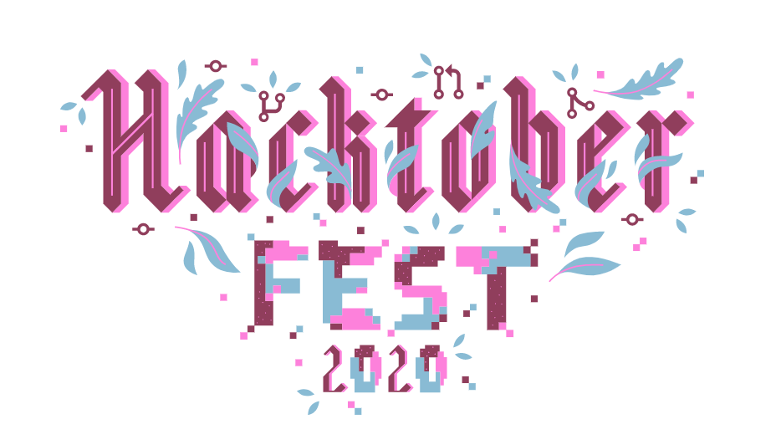

Join us for Hacktoberfest 2020!
Follow us at @infernoredtech for details and swag.
Notes:
One more plug for Hacktoberfest. If you're interested, follow IRT on Twitter.
I'll open it up to questions now and feel free to contact me afterwards as well.

